Slide 1
Appendix A
Experimental Stimuli
Presented in order of lowest Trial Concreteness (TC) rating to highest
Correct answers marked with blue box

Slide 2
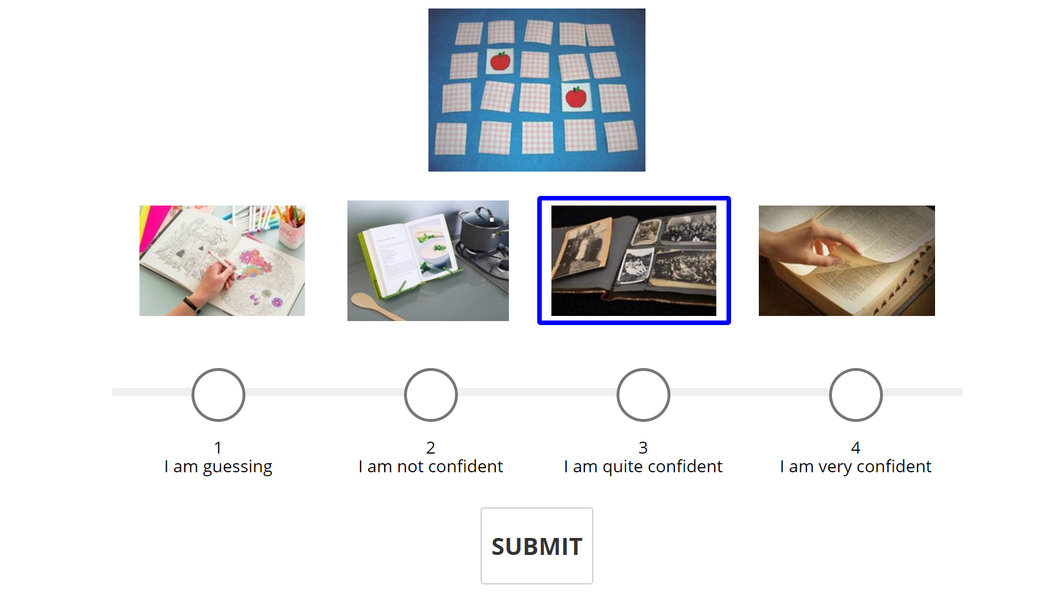
Linking word: memory Trial Concreteness (TC): -1.66 Common Setting (COM): -1.68 Visual Similarity (VIS): 0.02

Slide 3
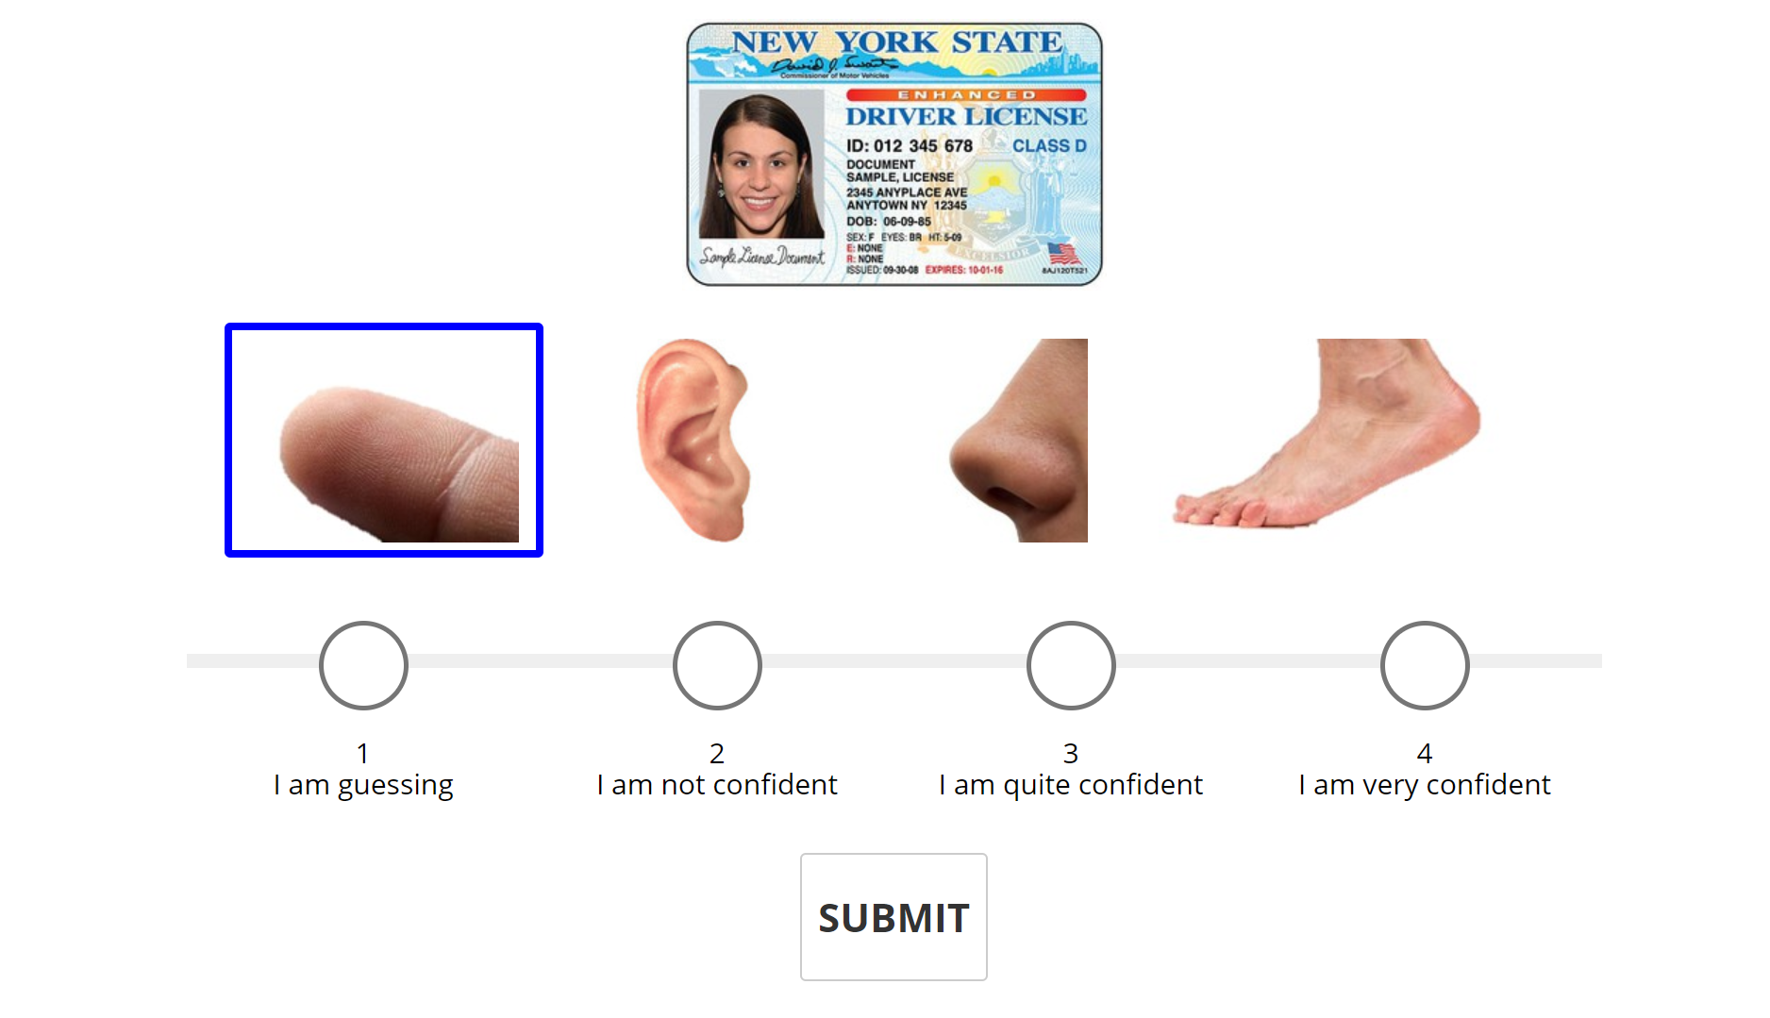
Linking word: identification Trial Concreteness (TC): -1.6 Common Setting (COM): -0.64 Visual Similarity (VIS): -0.96

Slide 4
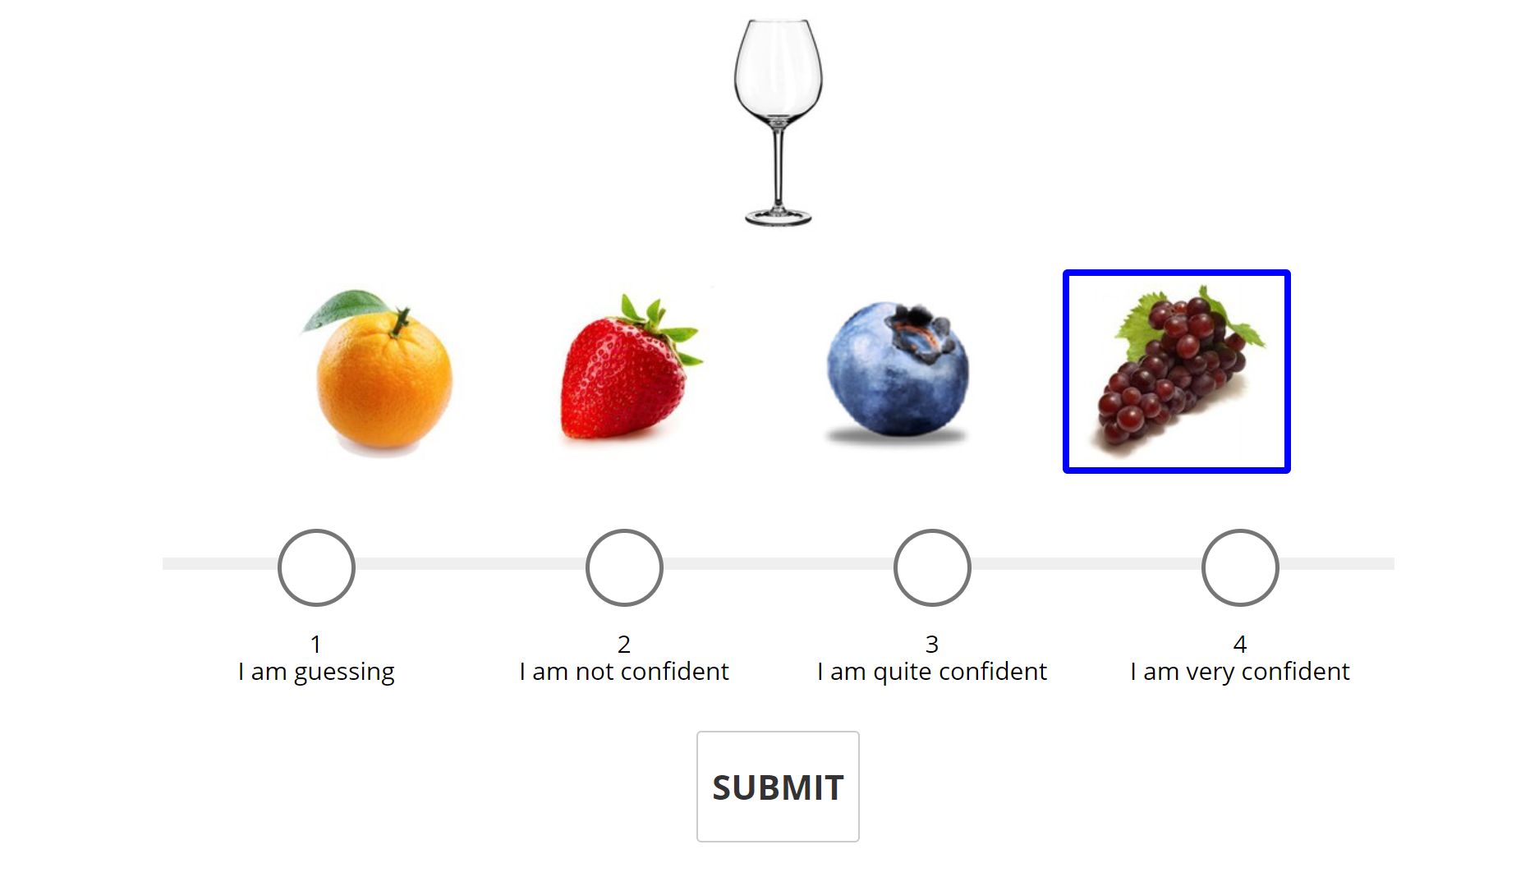
Linking word: wine Trial Concreteness (TC): -1.27 Common Setting (COM): 1.38 Visual Similarity (VIS): -2.65

Slide 5
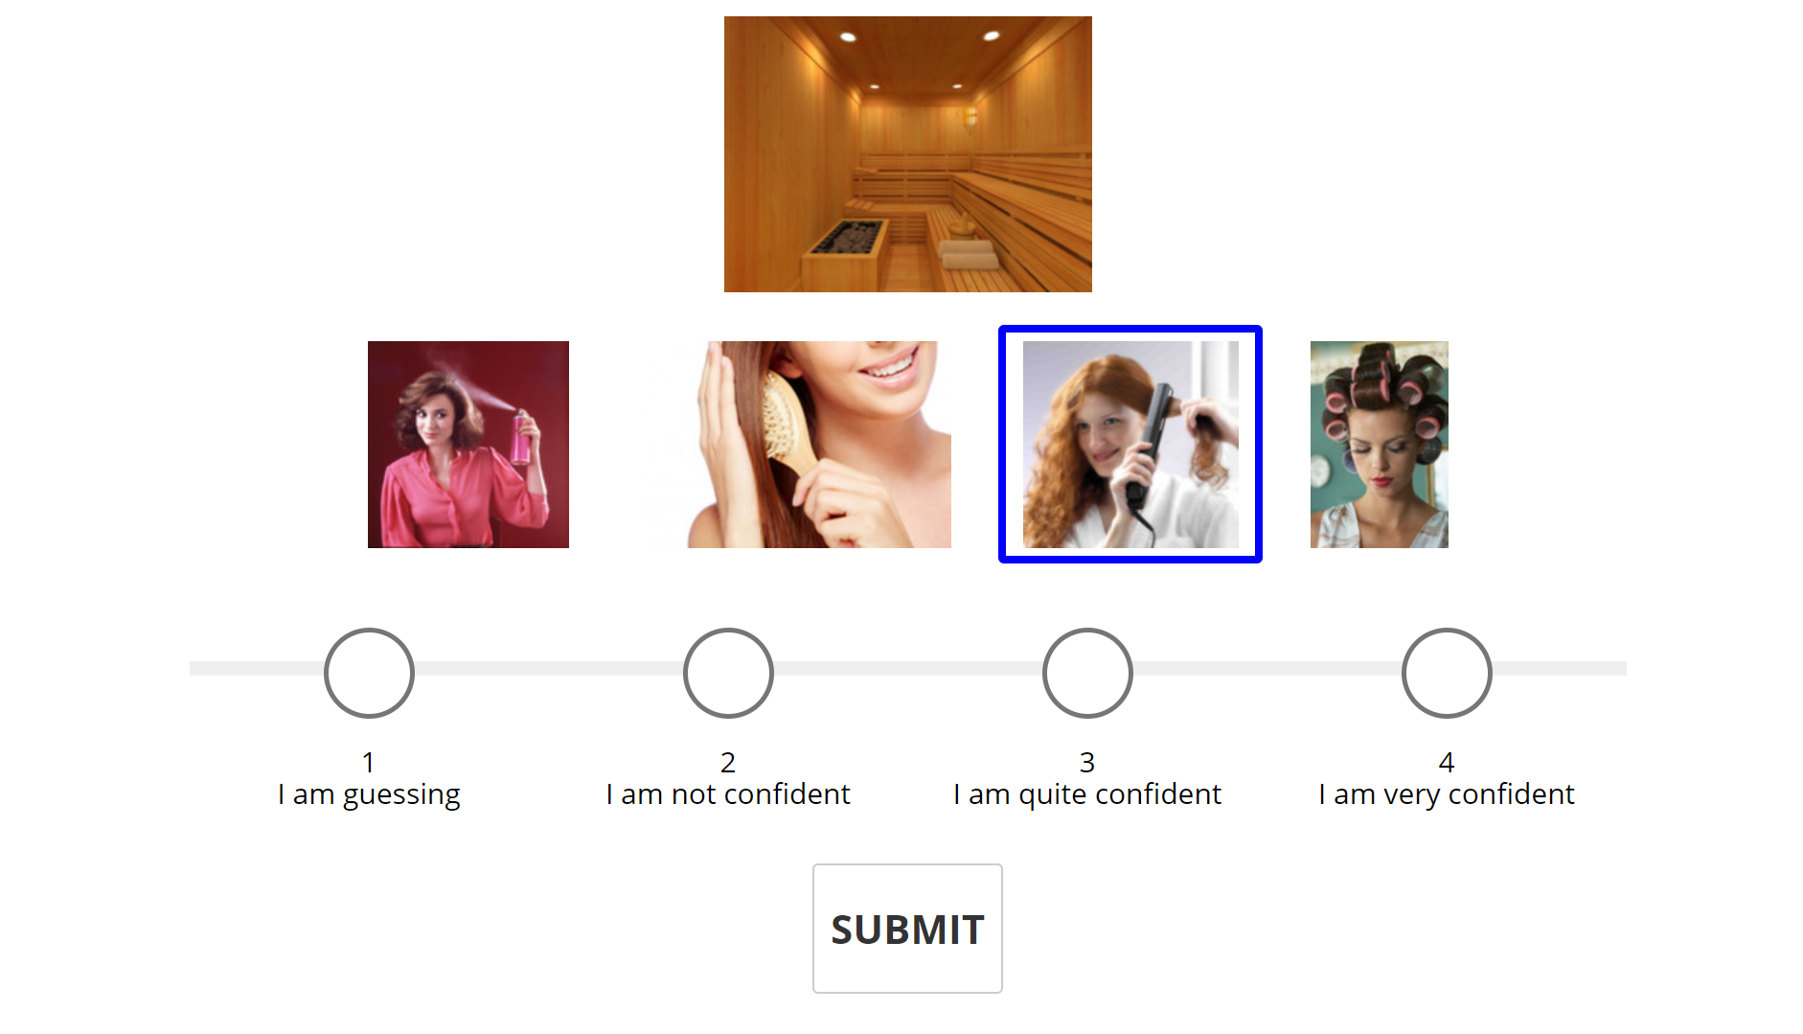
Linking word: hot Trial Concreteness (TC): -1.04 Common Setting (COM): -0.96 Visual Similarity (VIS): -0.08

Slide 6
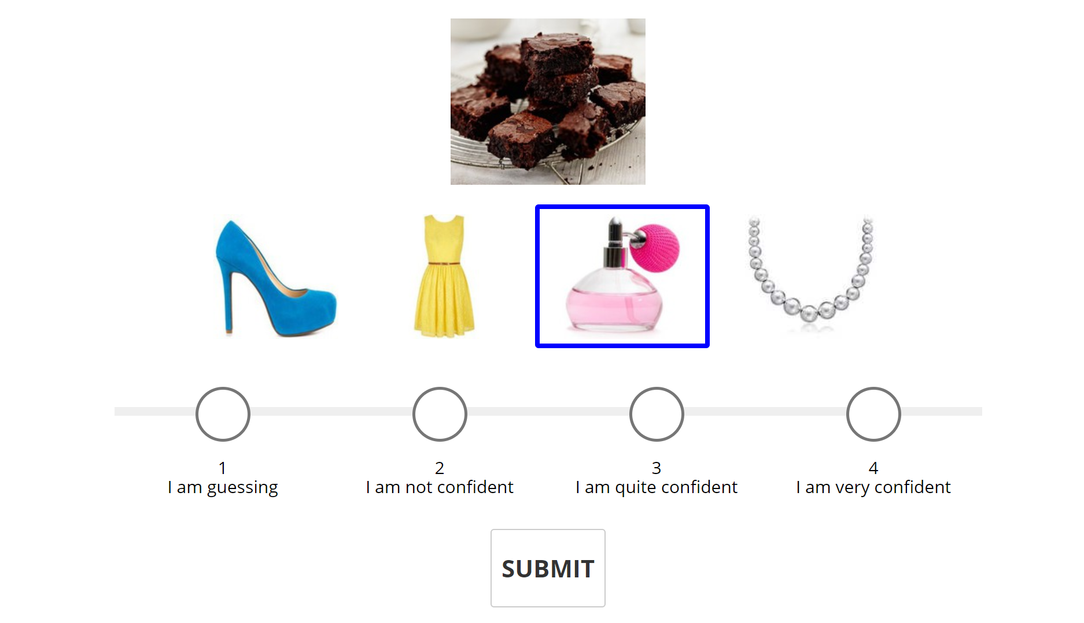
Linking word: scent Trial Concreteness (TC): -0.71 Common Setting (COM): -0.76 Visual Similarity (VIS): 0.05

Slide 7
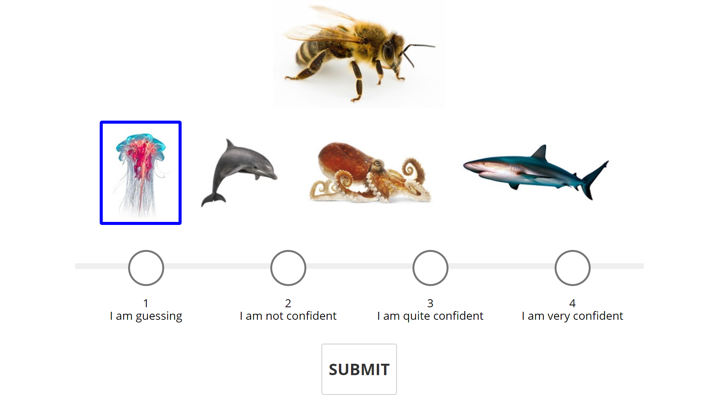
Linking word: sting Trial Concreteness (TC): -0.65 Common Setting (COM): -0.04 Visual Similarity (VIS): -0.61

Slide 8
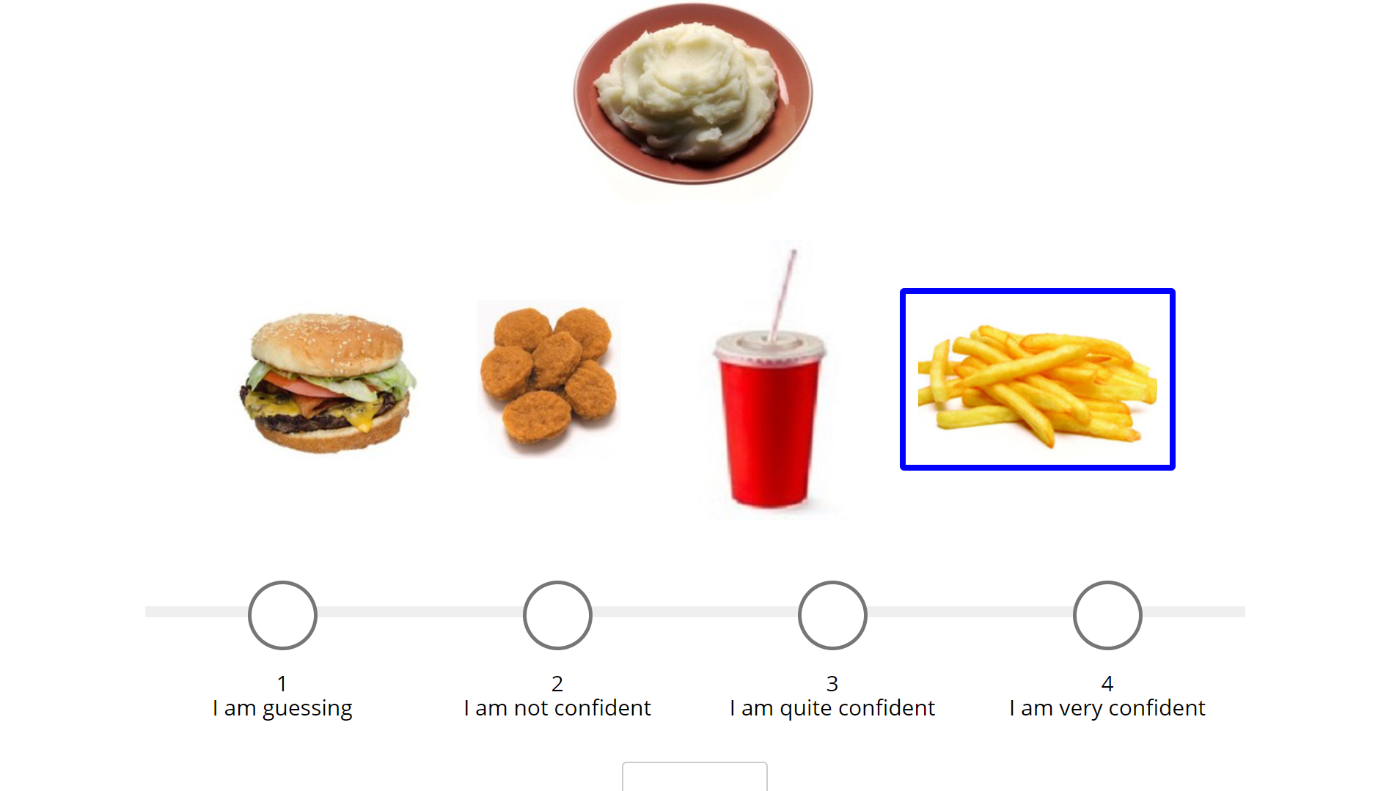

Linking word: potato Trial Concreteness (TC): -0.46 Common Setting (COM): -1.38 Visual Similarity (VIS): 0.92

Slide 9
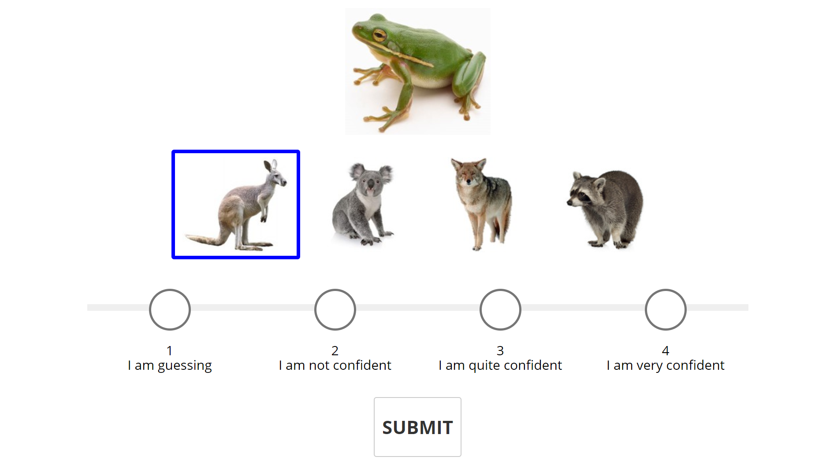
Linking word: jump Trial Concreteness (TC): -0.32 Common Setting (COM): -0.15 Visual Similarity (VIS): -0.17

Slide 10
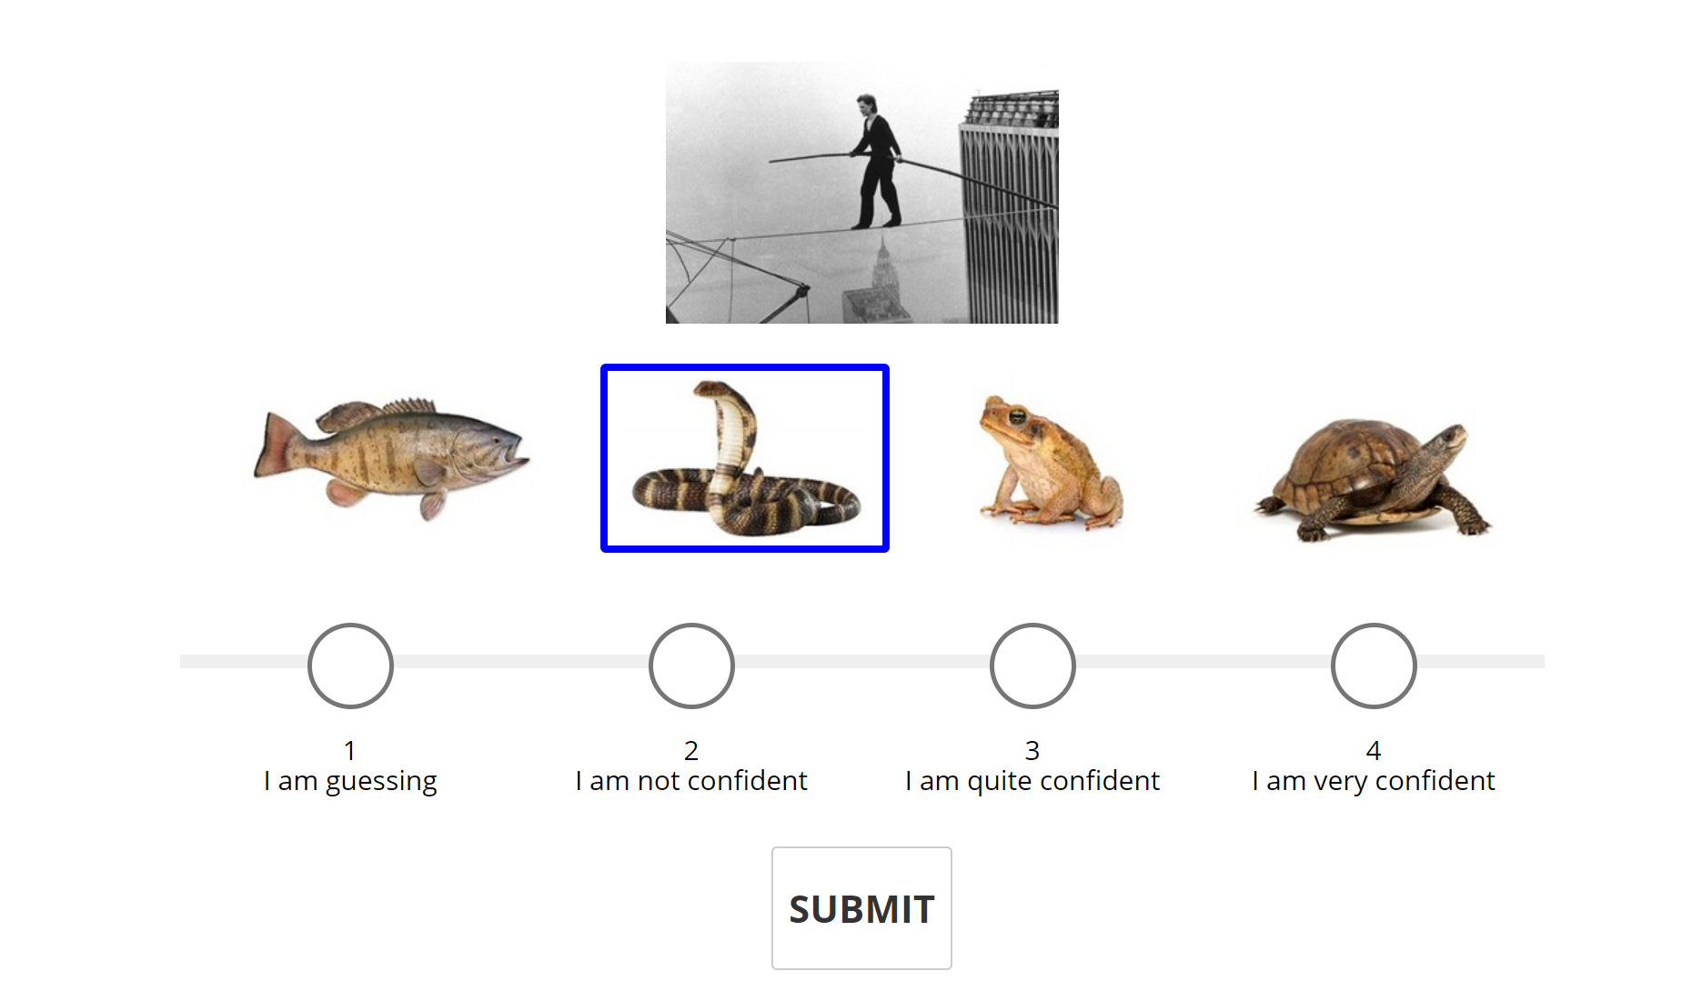
Linking word: danger Trial Concreteness (TC): -0.25 Common Setting (COM): -0.21 Visual Similarity (VIS): -0.04

Slide 11
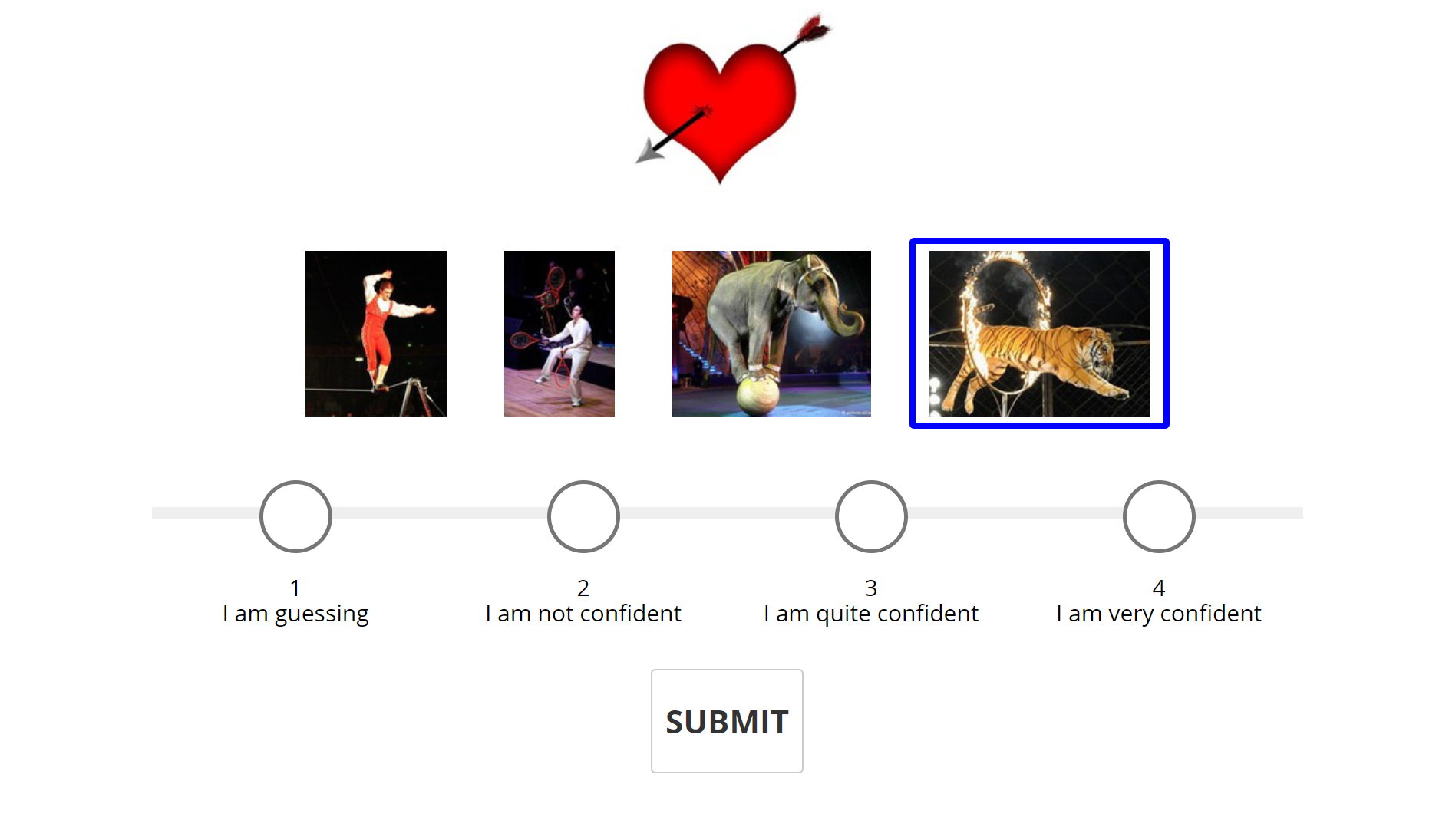
Linking word: through Trial Concreteness (TC): -0.25 Common Setting (COM): -0.21 Visual Similarity (VIS): -0.04

Slide 12
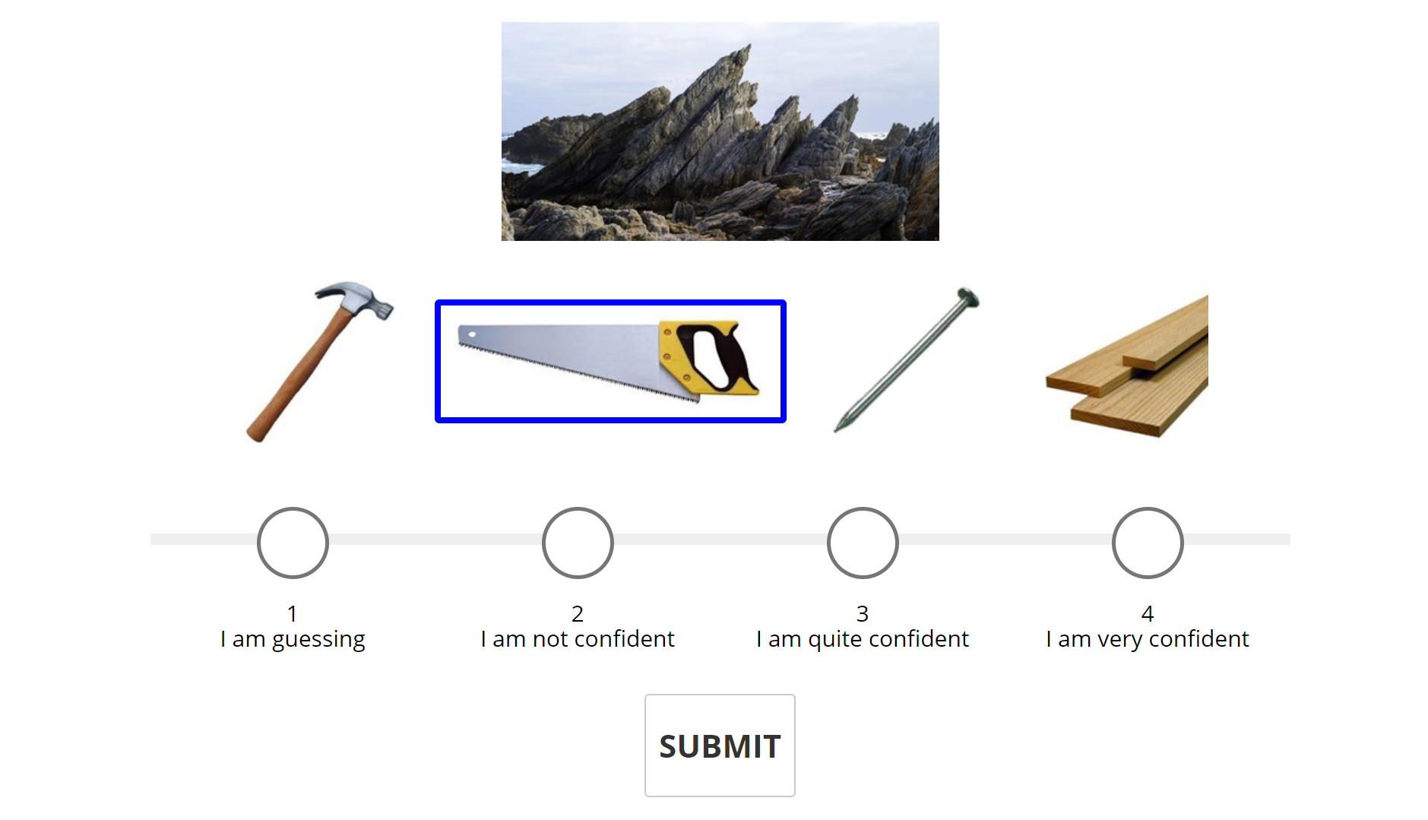
Linking word: jagged Trial Concreteness (TC): -0.18 Common Setting (COM): -0.14 Visual Similarity (VIS): -0.04

Slide 13
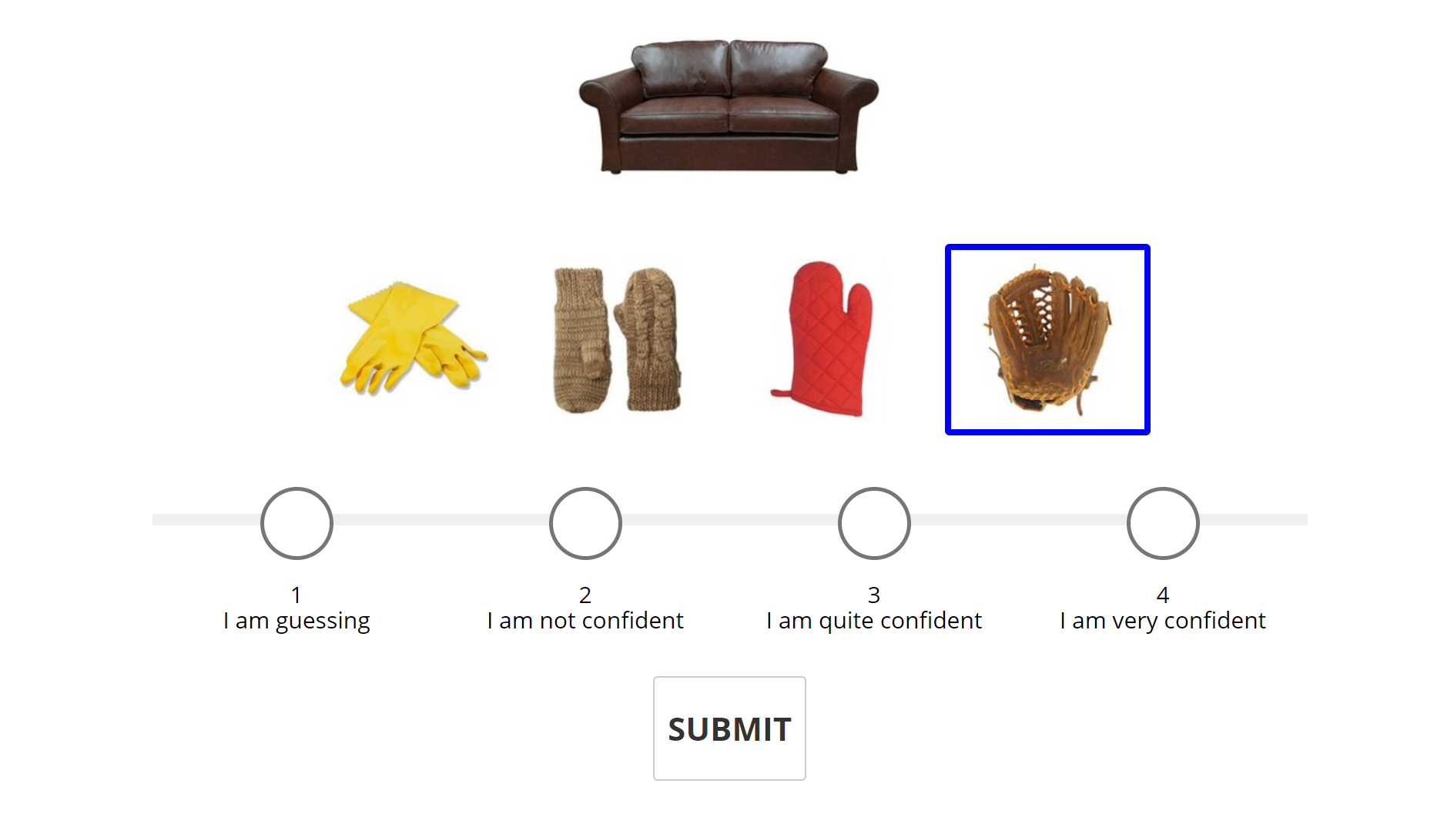
Linking word: leather Trial Concreteness (TC): -0.14 Common Setting (COM): -0.92 Visual Similarity (VIS): 0.78

Slide 14
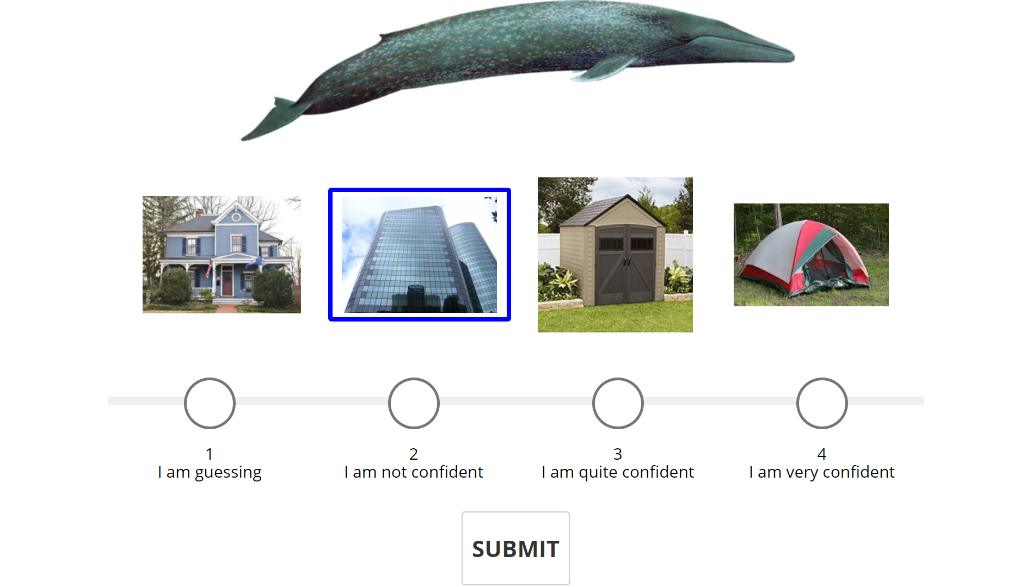
Linking word: large Trial Concreteness (TC): -0.11 Common Setting (COM): 0.07 Visual Similarity (VIS): -0.18

Slide 15
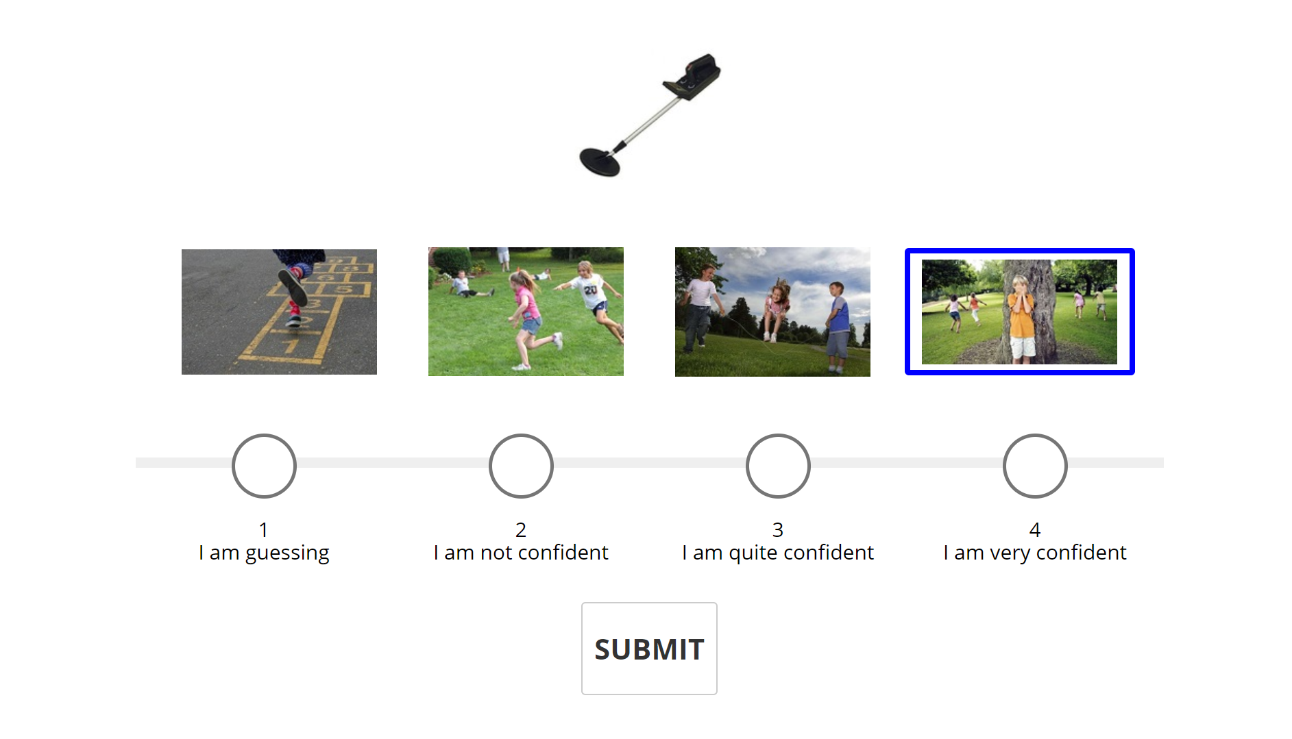
Linking word: find Trial Concreteness (TC): -0.1 Common Setting (COM): 0 Visual Similarity (VIS): -0.1

Slide 16
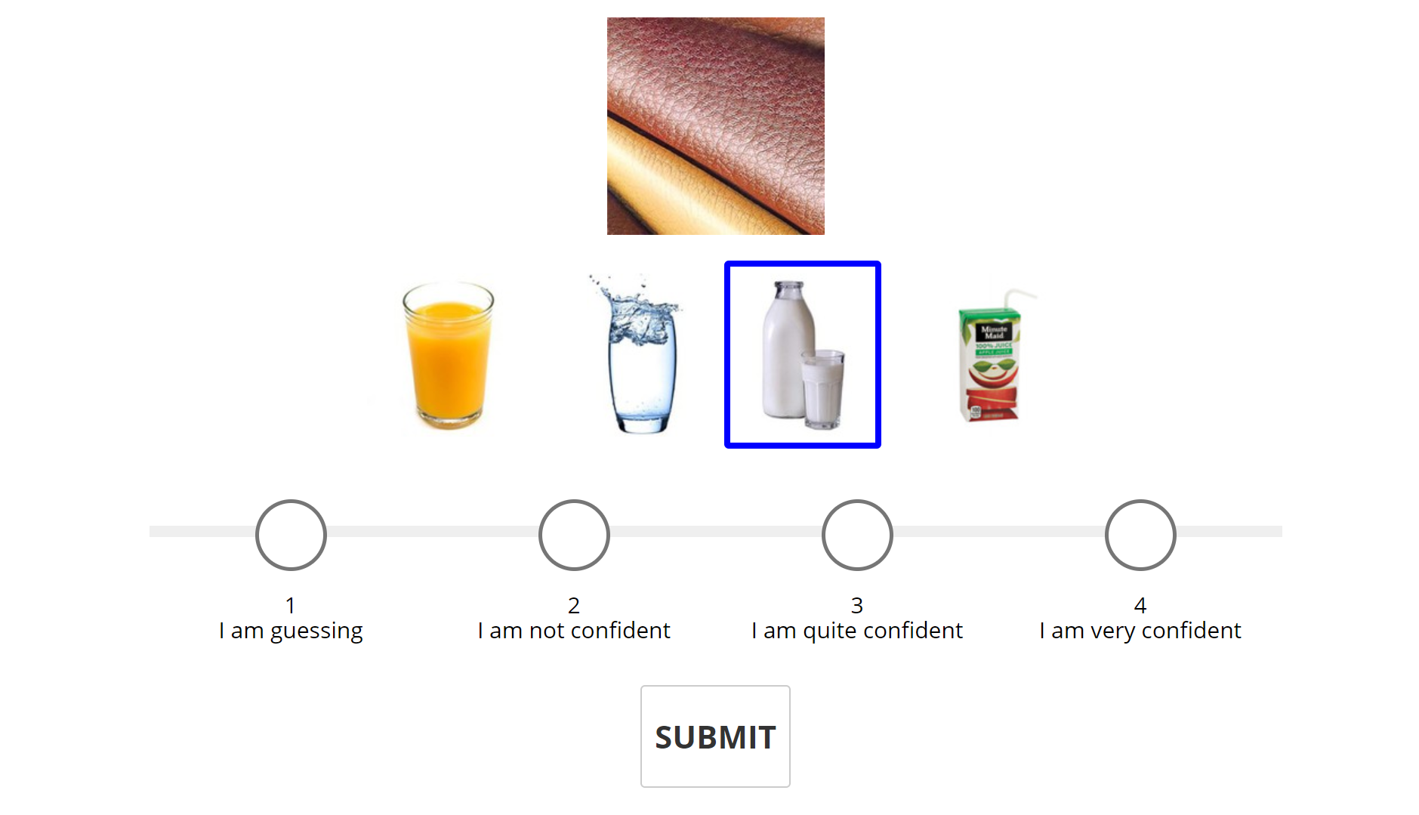
Linking word: cow Trial Concreteness (TC): 0 Common Setting (COM): -0.02 Visual Similarity (VIS): 0.02

Slide 17
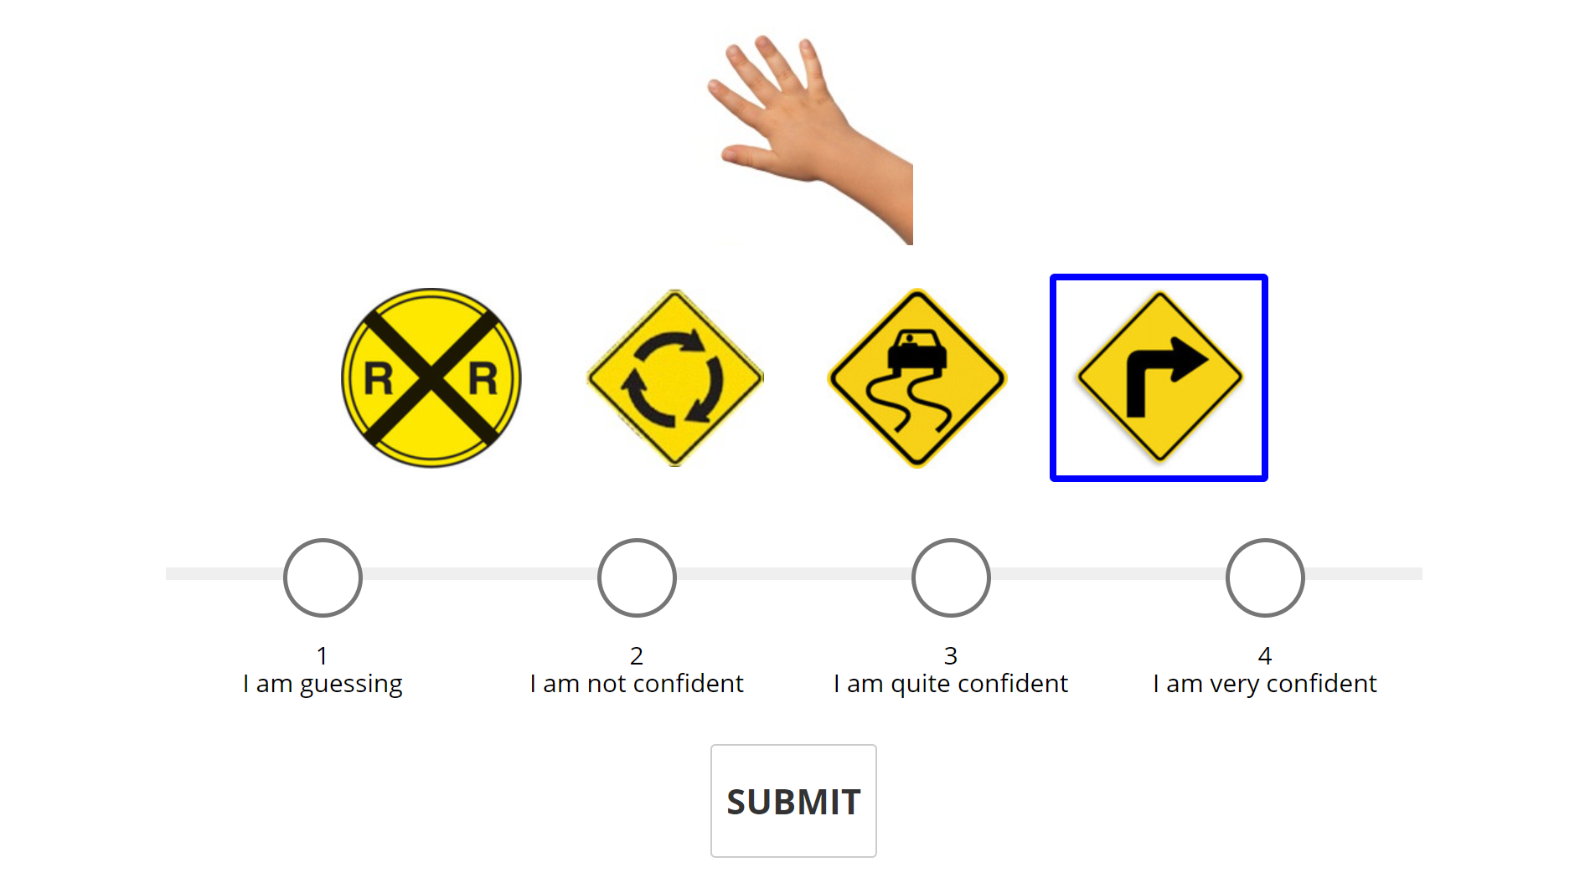
Linking word: right Trial Concreteness (TC): 0 Common Setting (COM): 0.02 Visual Similarity (VIS): -0.02

Slide 18
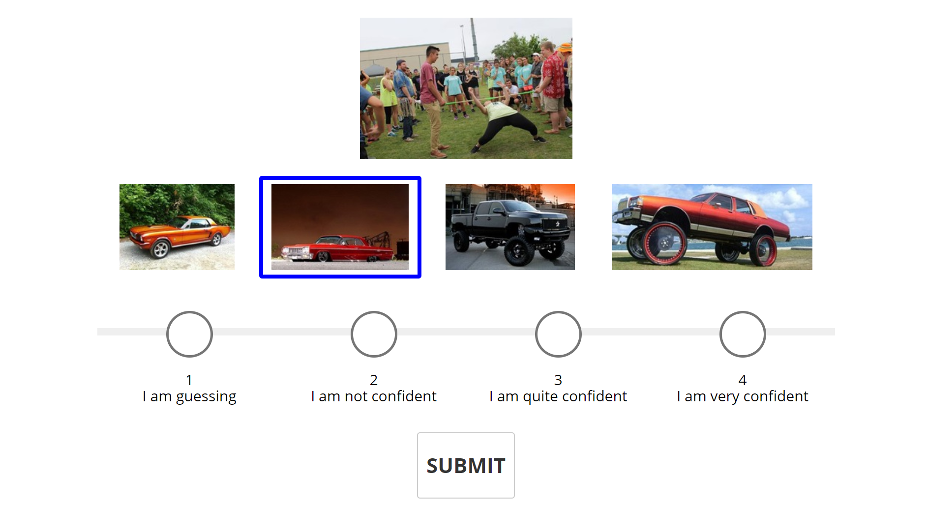
Linking word: low Trial Concreteness (TC): 0.3 Common Setting (COM): -0.1 Visual Similarity (VIS): 0.4

Slide 19
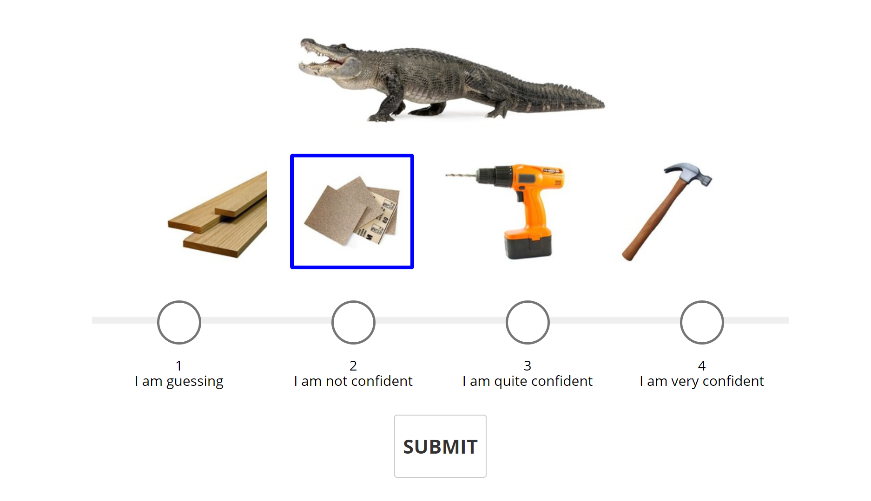
Linking word: rough Trial Concreteness (TC): 0.315 Common Setting (COM):-0.06 Visual Similarity (VIS): 0.375

Slide 20
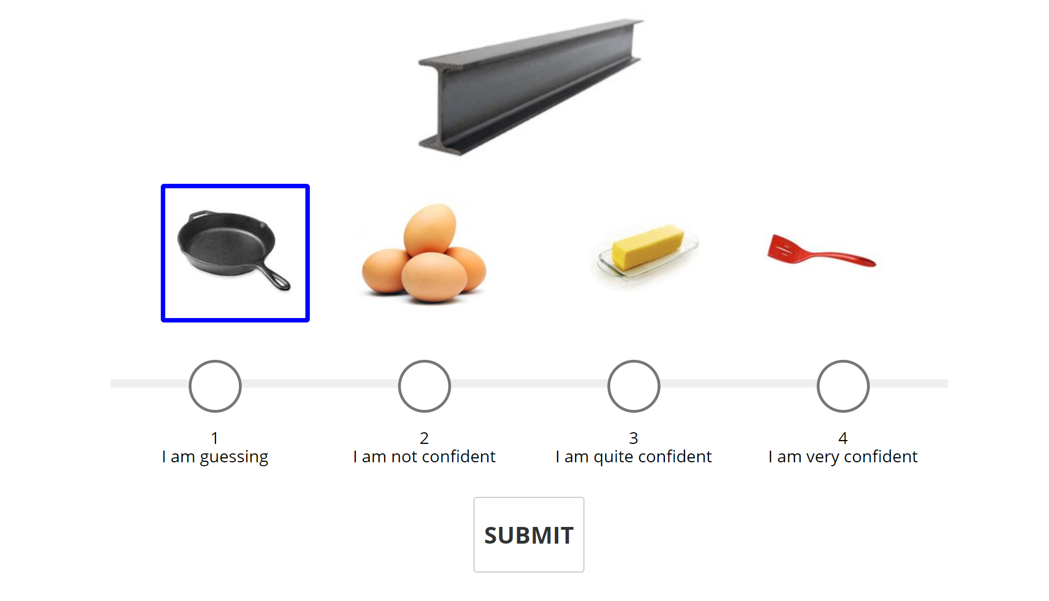
Linking word: iron Trial Concreteness (TC): 0.54 Common Setting (COM): 0.2 Visual Similarity (VIS): 0.34

Slide 21
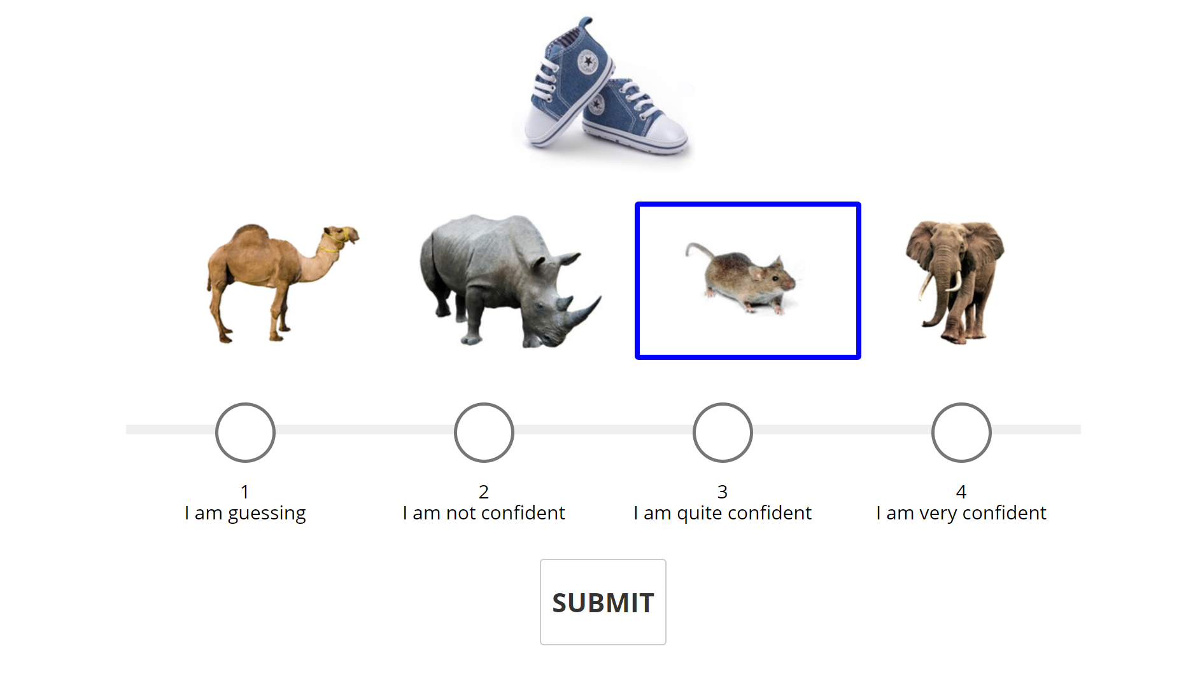
Linking word: small Trial Concreteness (TC): 0.57 Common Setting (COM): 0.32 Visual Similarity (VIS):0.25

Slide 22
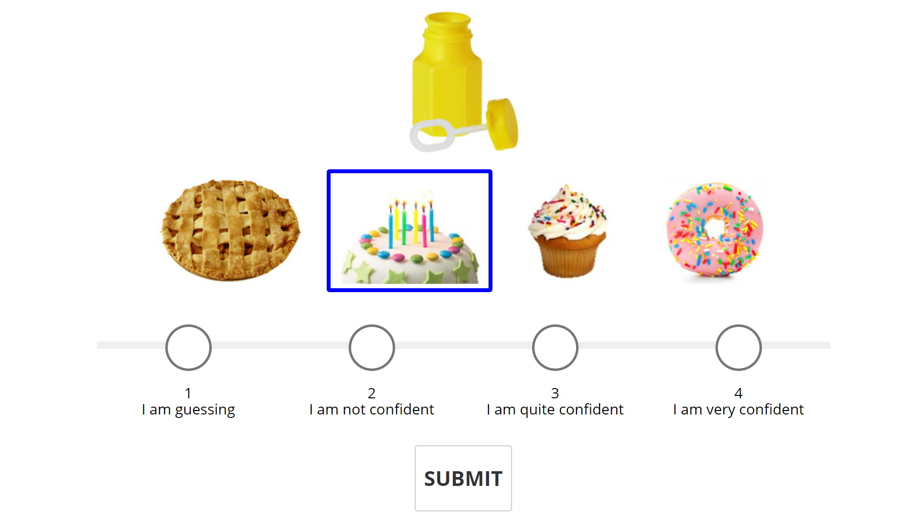
Linking word: blow Trial Concreteness (TC): 0.62 Common Setting (COM): 0.62 Visual Similarity (VIS): 0

Slide 23
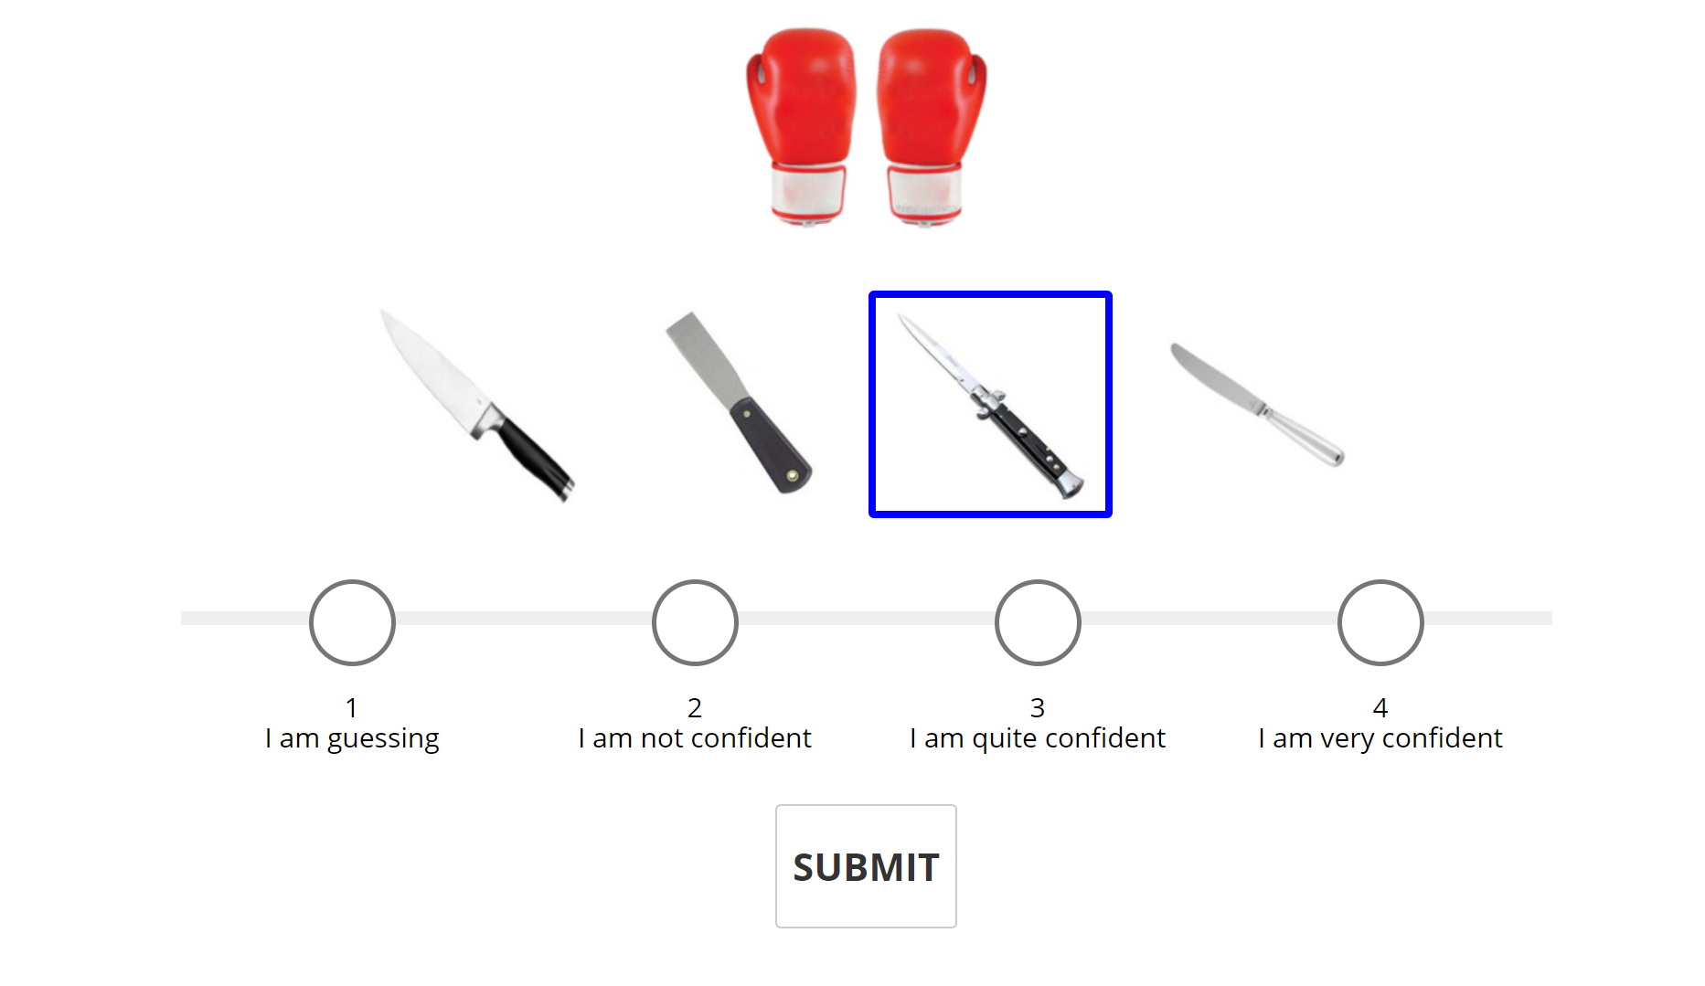
Linking word: fight Trial Concreteness (TC): 0.66 Common Setting (COM): 0.54 Visual Similarity (VIS): 0.12

Slide 24
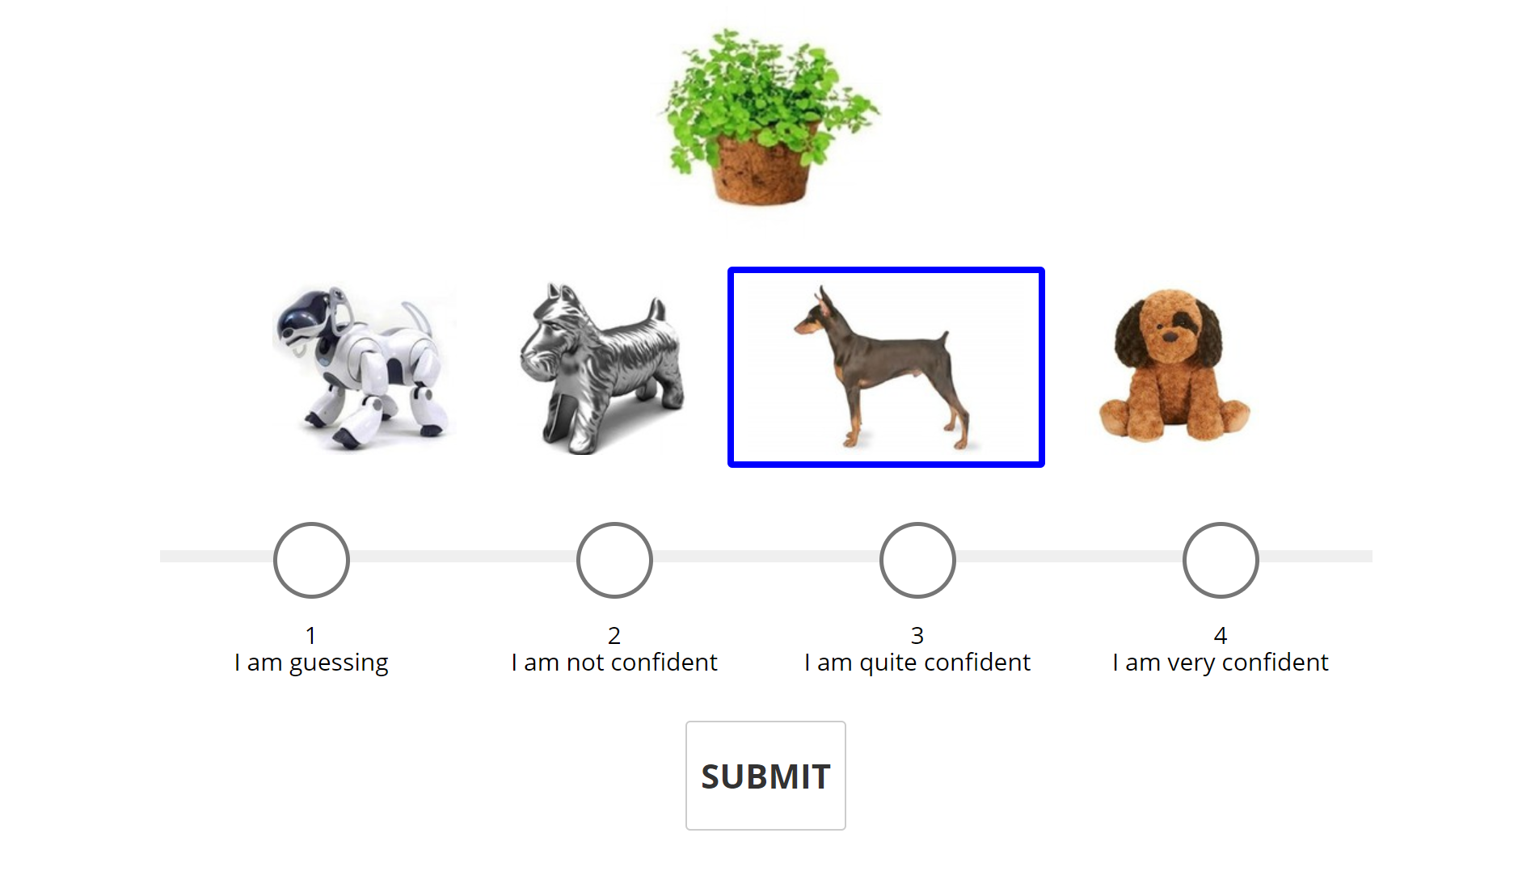
Linking word: alive Trial Concreteness (TC): 0.72 Common Setting (COM): 0.76 Visual Similarity (VIS): -0.04

Slide 25
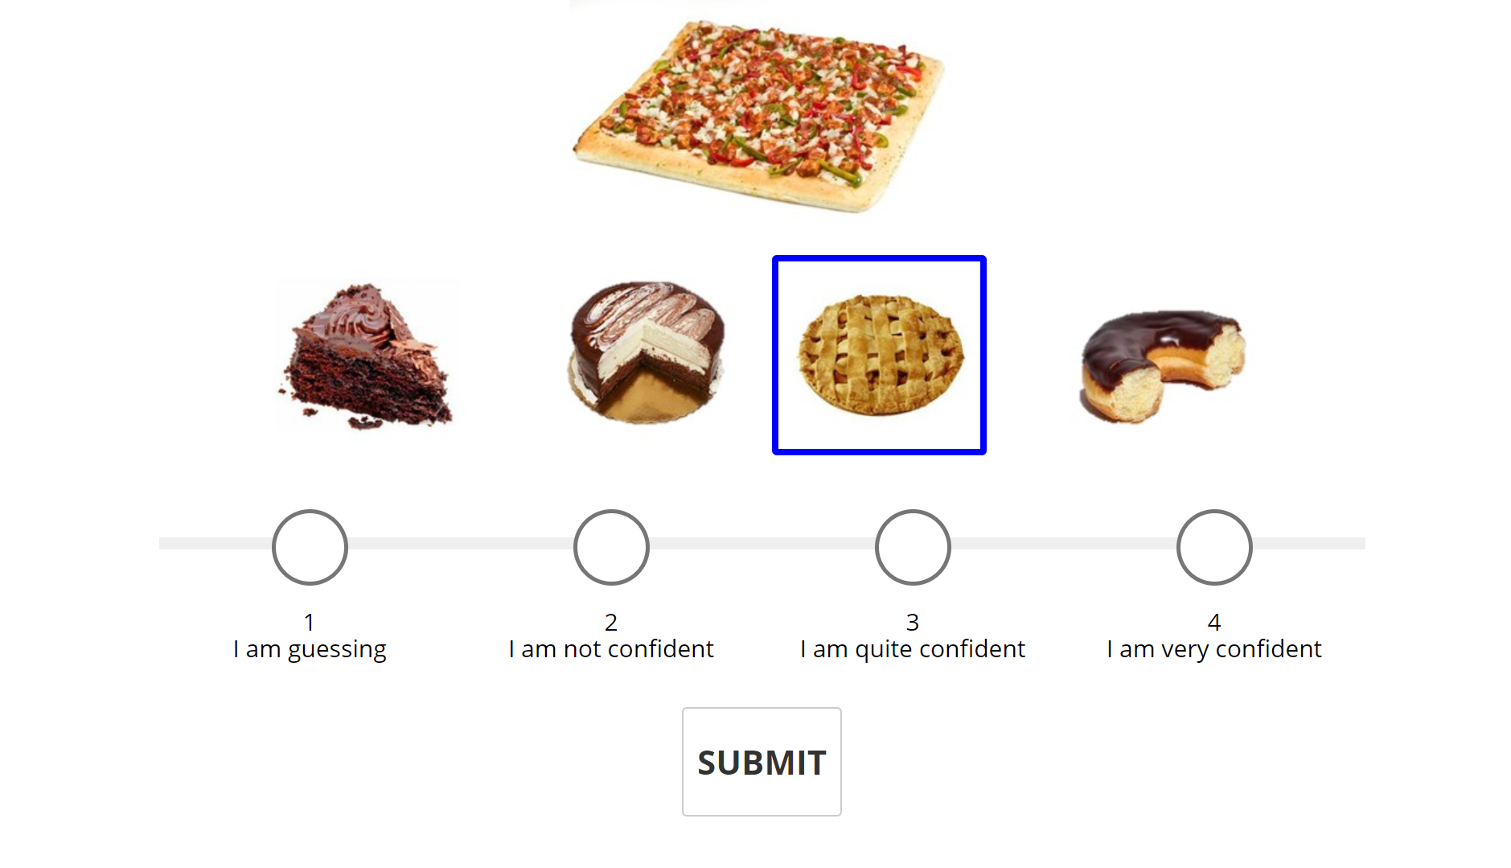
Linking word: whole Trial Concreteness (TC):0.73 Common Setting (COM): -0.23 Visual Similarity (VIS): 0.96

Slide 26
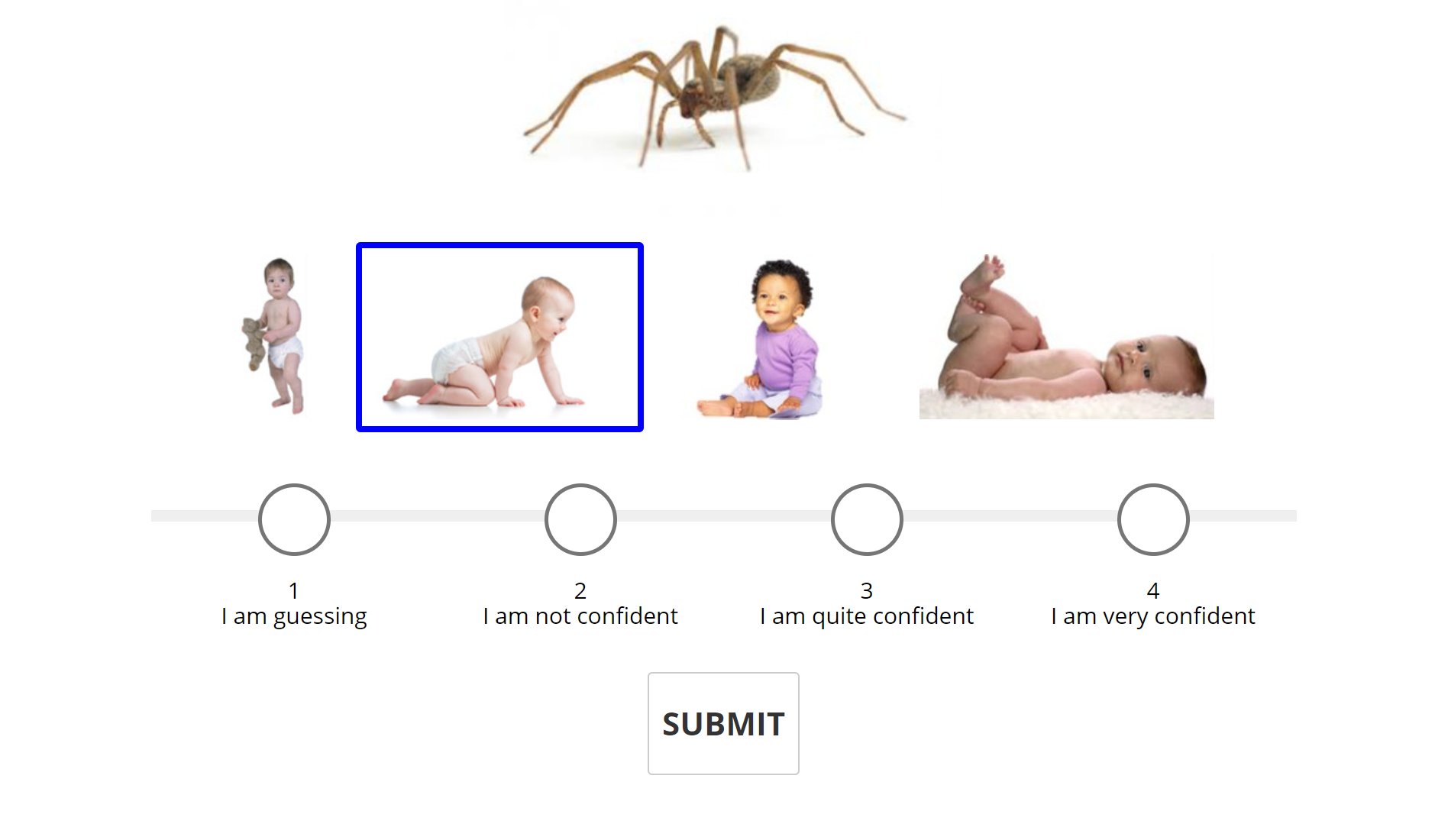
Linking word: crawl Trial Concreteness (TC): 0.76 Common Setting (COM): 0.04 Visual Similarity (VIS):0.72

Slide 27
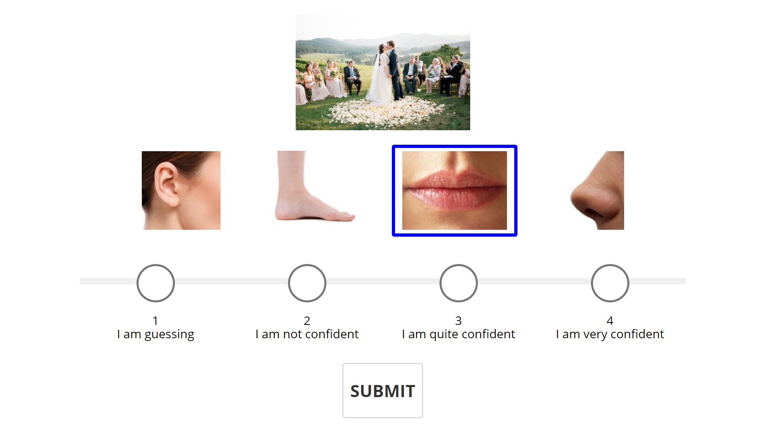
Linking word: kiss Trial Concreteness (TC):0.82 Common Setting (COM): 0.46 Visual Similarity (VIS): 0.36

Slide 28
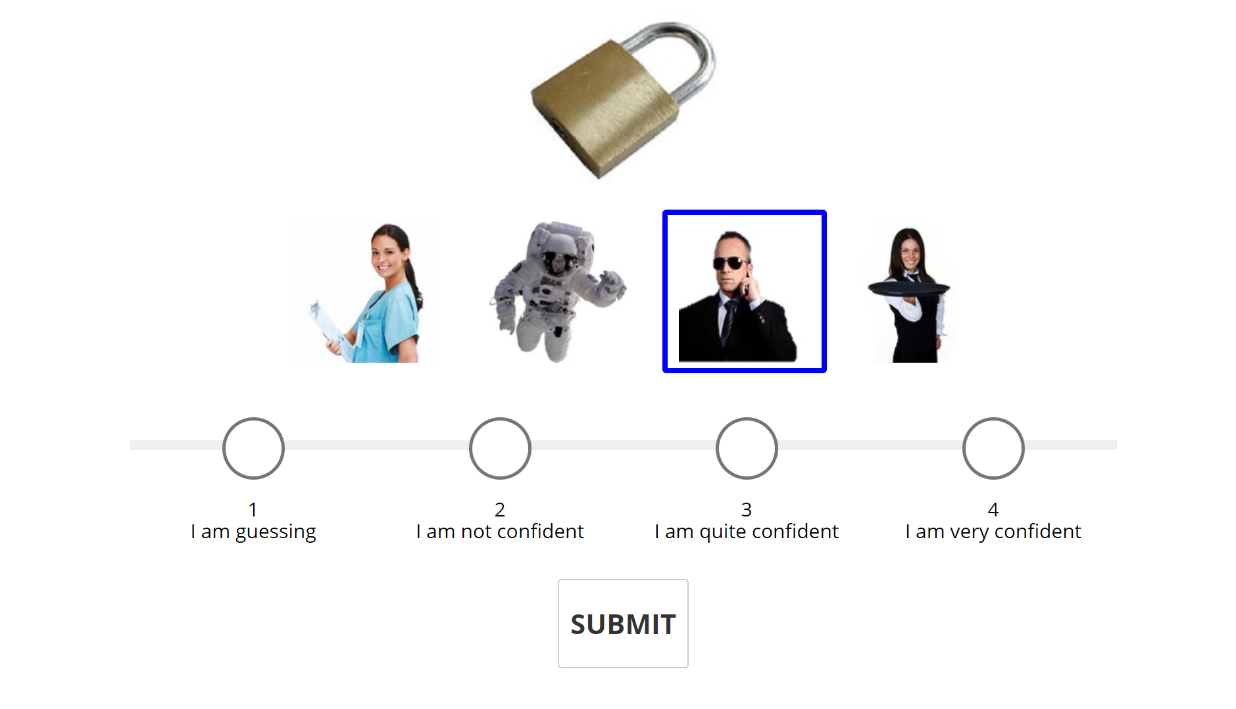
Linking word: security Trial Concreteness (TC):0.82 Common Setting (COM): 0.66 Visual Similarity (VIS): 0.16

Slide 29
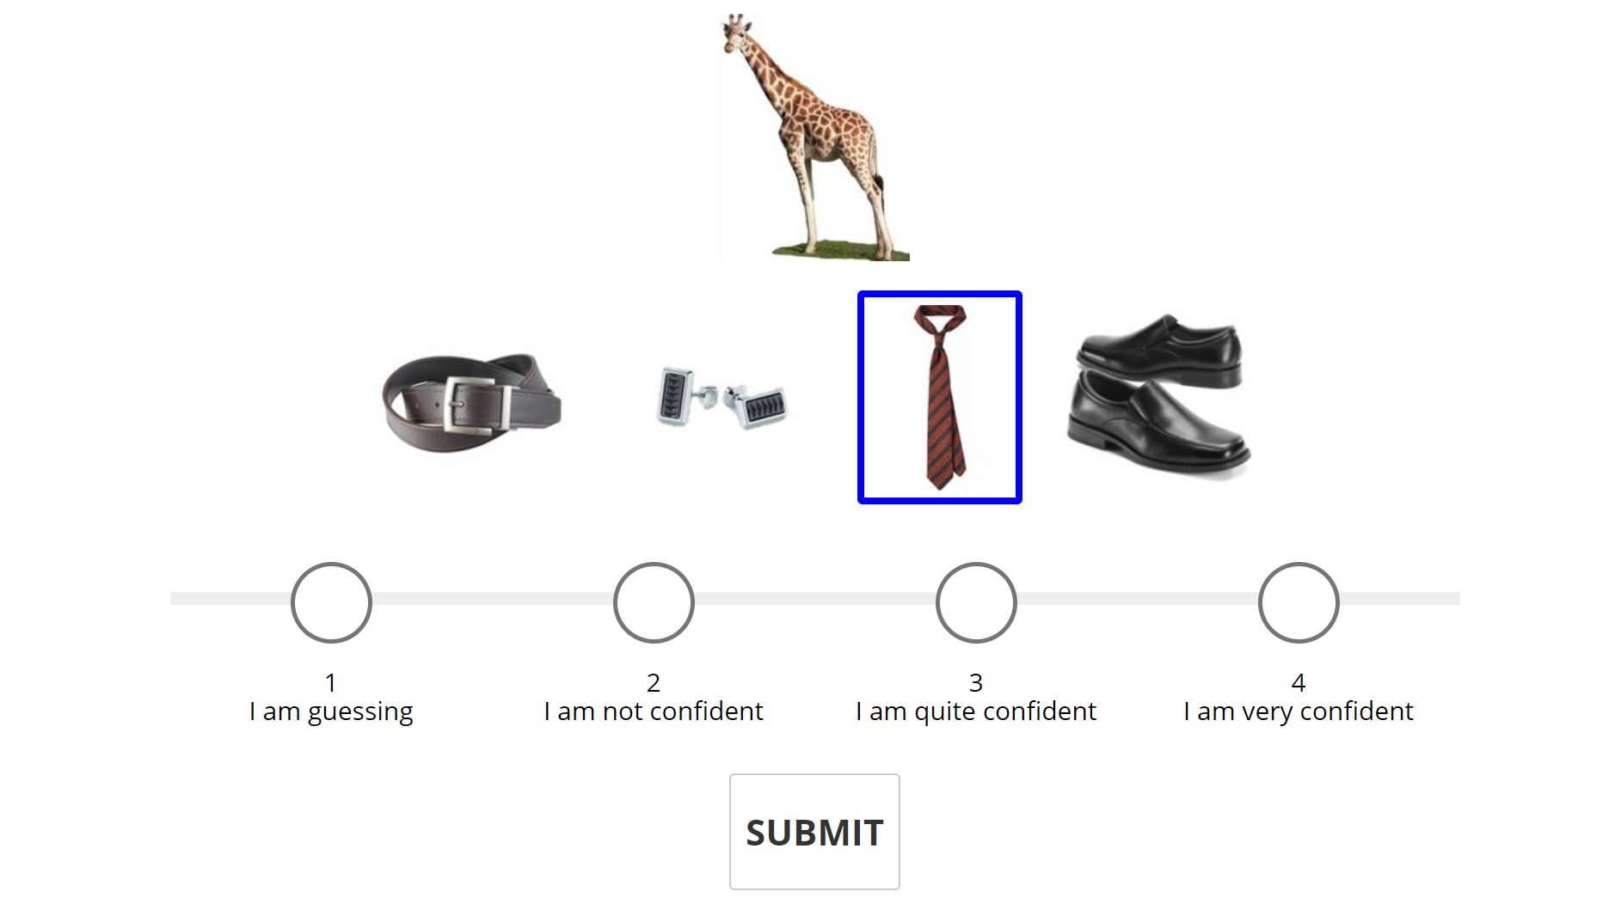
Linking word: neck Trial Concreteness (TC): 0.83 Common Setting (COM): -0.1 Visual Similarity (VIS): 0.93

Slide 30
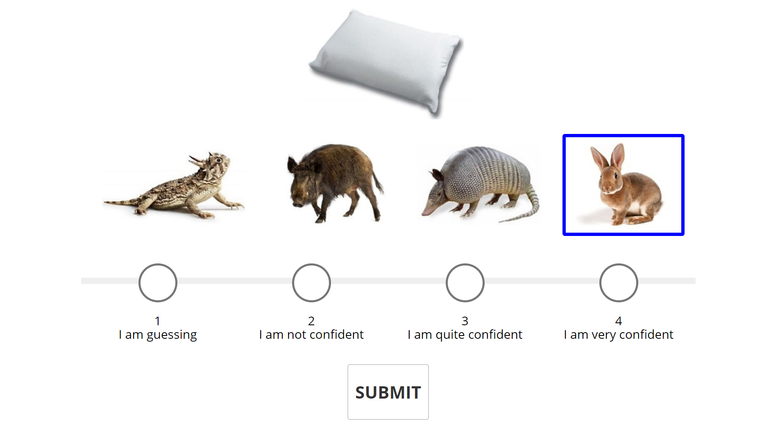
Linking word: soft Trial Concreteness (TC): 0.85 Common Setting (COM): 0.44 Visual Similarity (VIS): 0.41

Slide 31
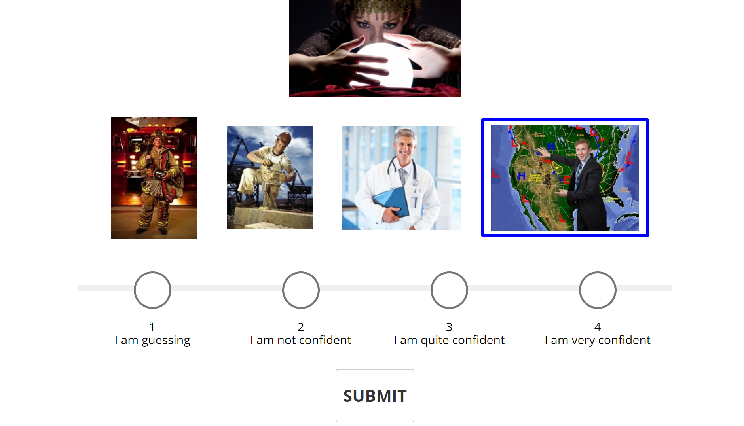
Linking word: predict Trial Concreteness (TC): 0.91 Common Setting (COM): 0.48 Visual Similarity (VIS): 0.43

Slide 32
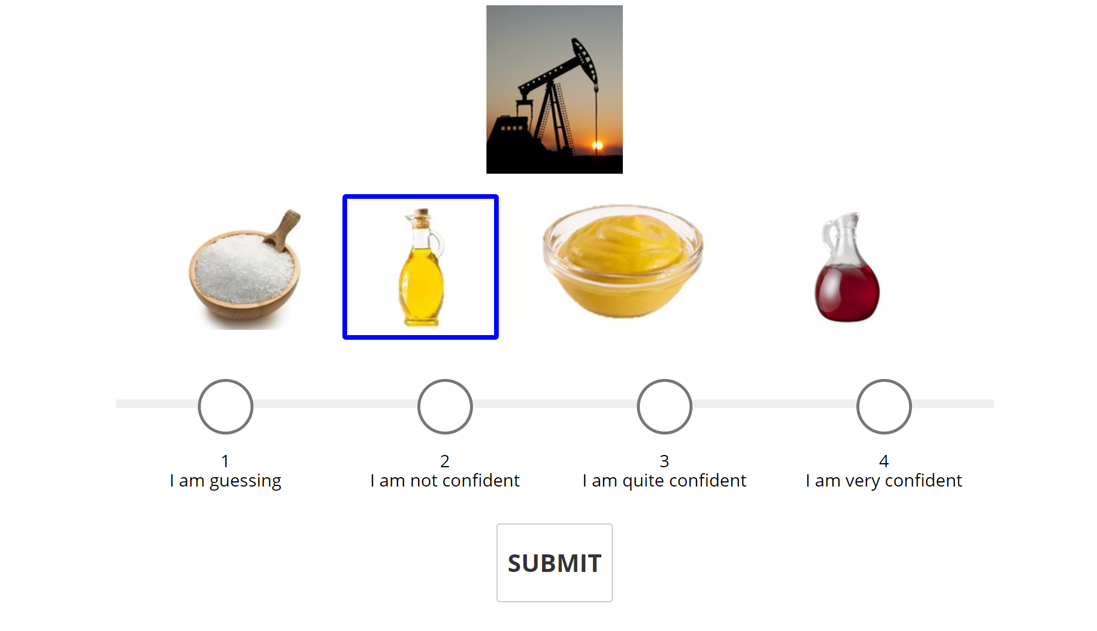
Linking word: oil Trial Concreteness (TC): 0.92 Common Setting (COM): 0.22 Visual Similarity (VIS): 0.7

Slide 33
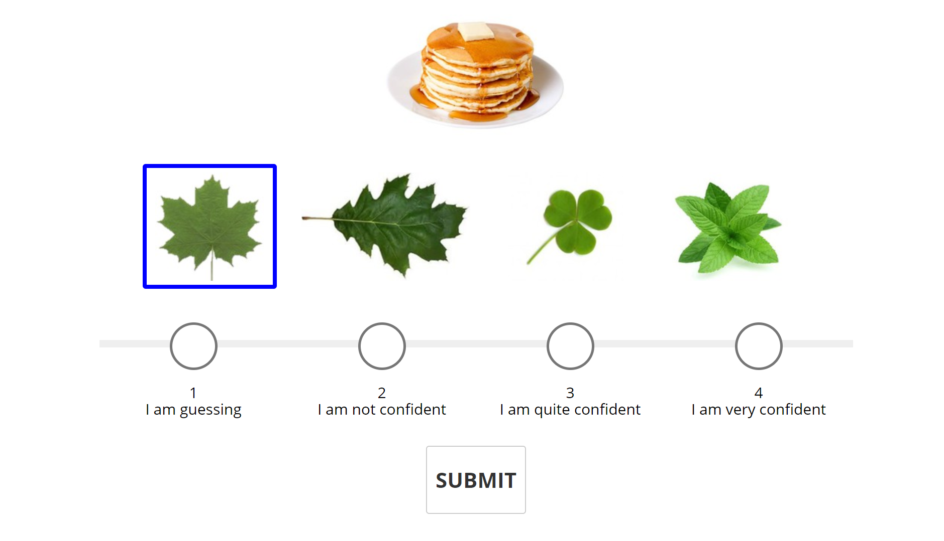
Linking word: maple Trial Concreteness (TC): 1.01 Common Setting (COM): 0.66 Visual Similarity (VIS): 0.35

Slide 34
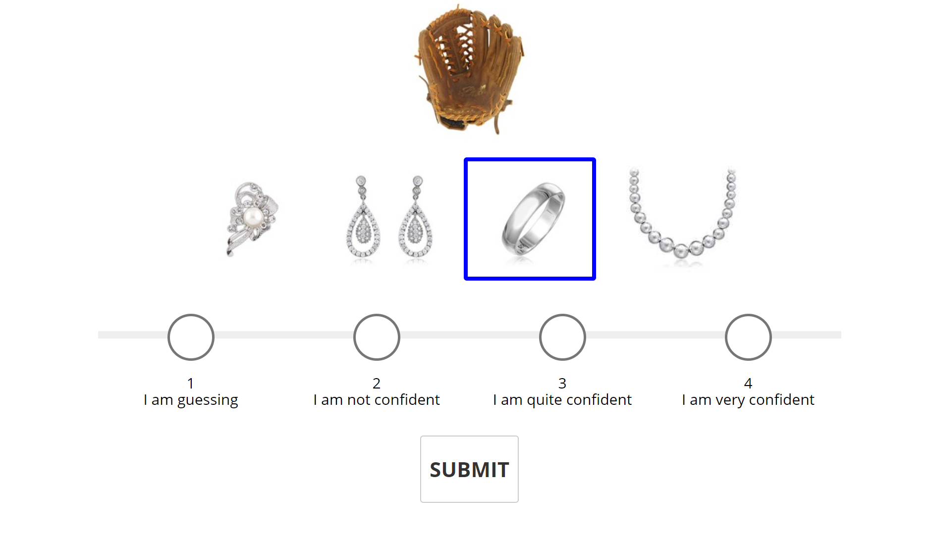
Linking word: hand Trial Concreteness (TC): 1.01 Common Setting (COM): 0.92 Visual Similarity (VIS):0.09

Slide 35
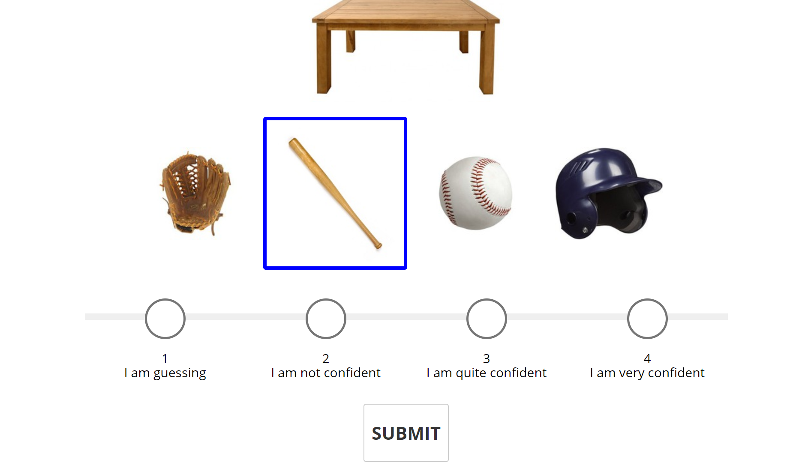
Linking word: wood Trial Concreteness (TC): 1.18 Common Setting (COM): 0.2 Visual Similarity (VIS): 0.98

Slide 36
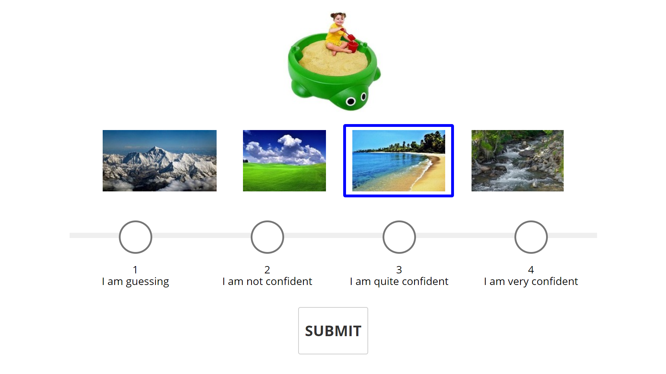
Linking word: sand Trial Concreteness (TC): 1.23 Common Setting (COM): 0.52 Visual Similarity (VIS): 0.71

Slide 37
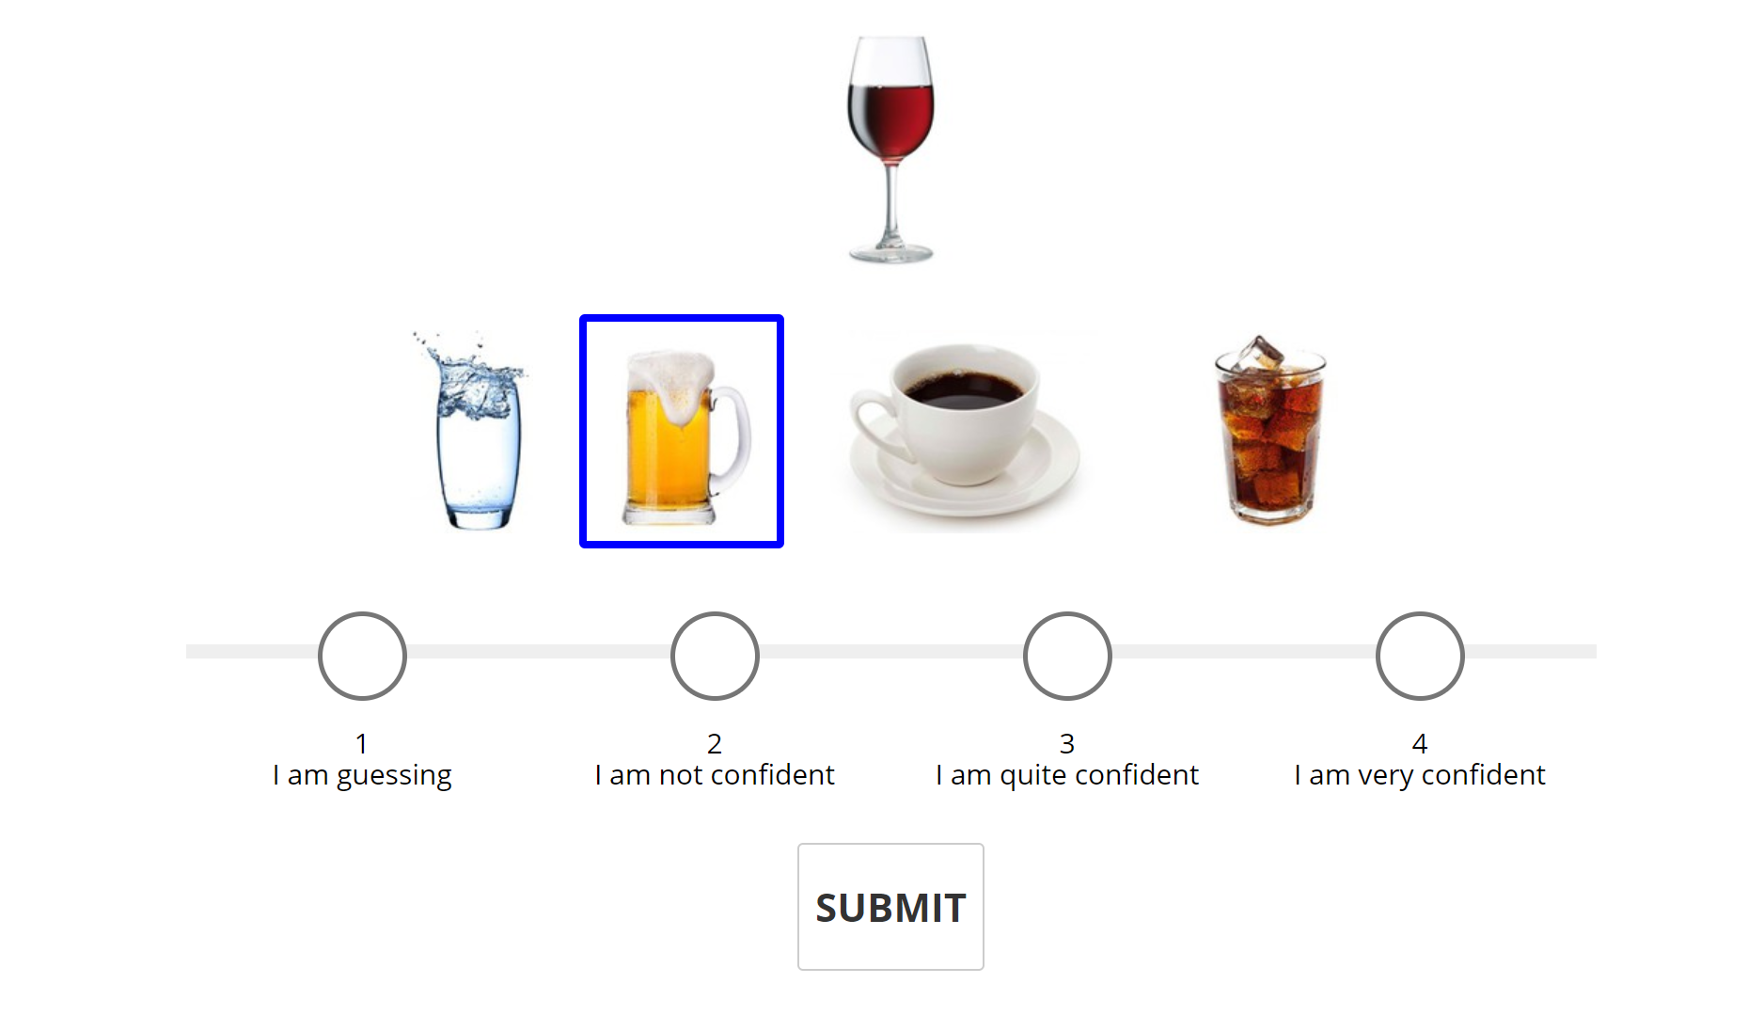
Linking word: alcohol Trial Concreteness (TC): 1.27 Common Setting (COM): 0.66 Visual Similarity (VIS): 0.61

Slide 38
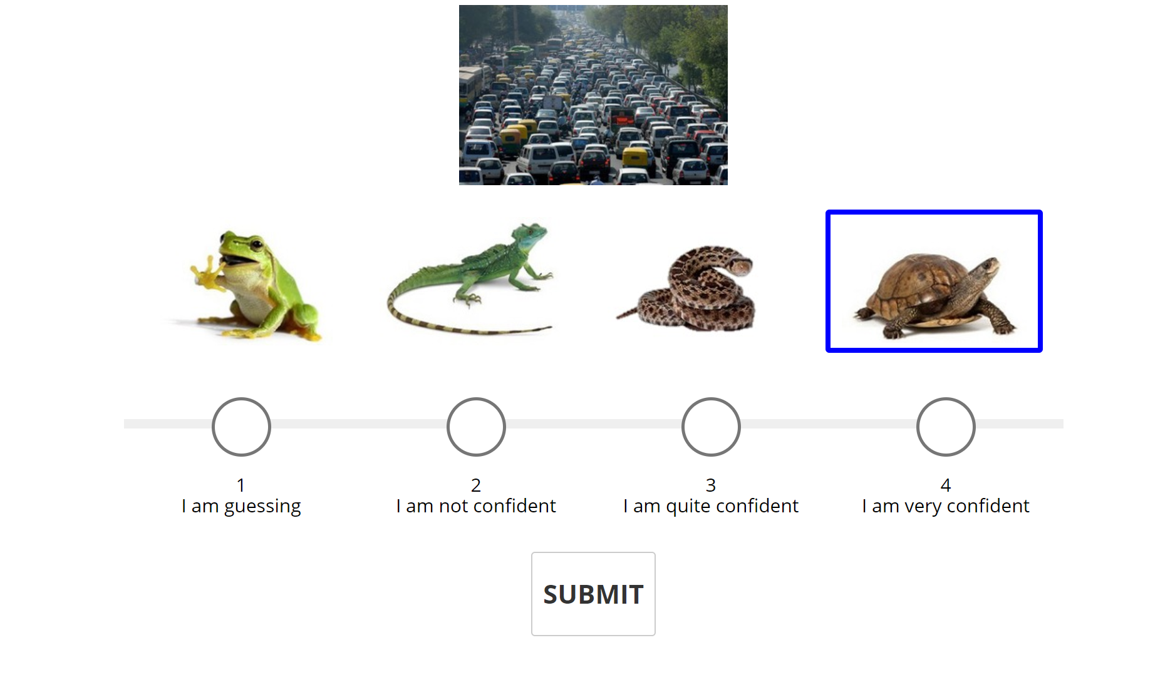
Linking word: slow Trial Concreteness (TC):1.32 Common Setting (COM): 0.58 Visual Similarity (VIS): 0.74

Slide 39
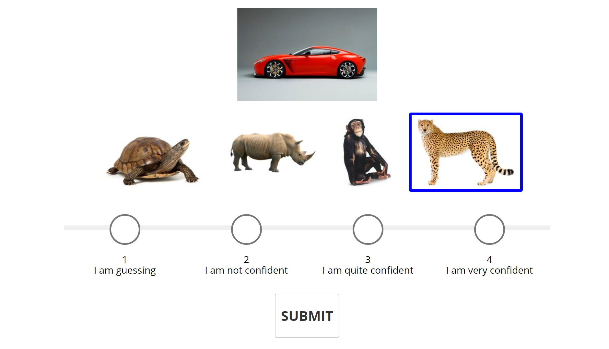
Linking word: fast Trial Concreteness (TC): 1.32 Common Setting (COM): 0.6 Visual Similarity (VIS):0.72

Slide 40
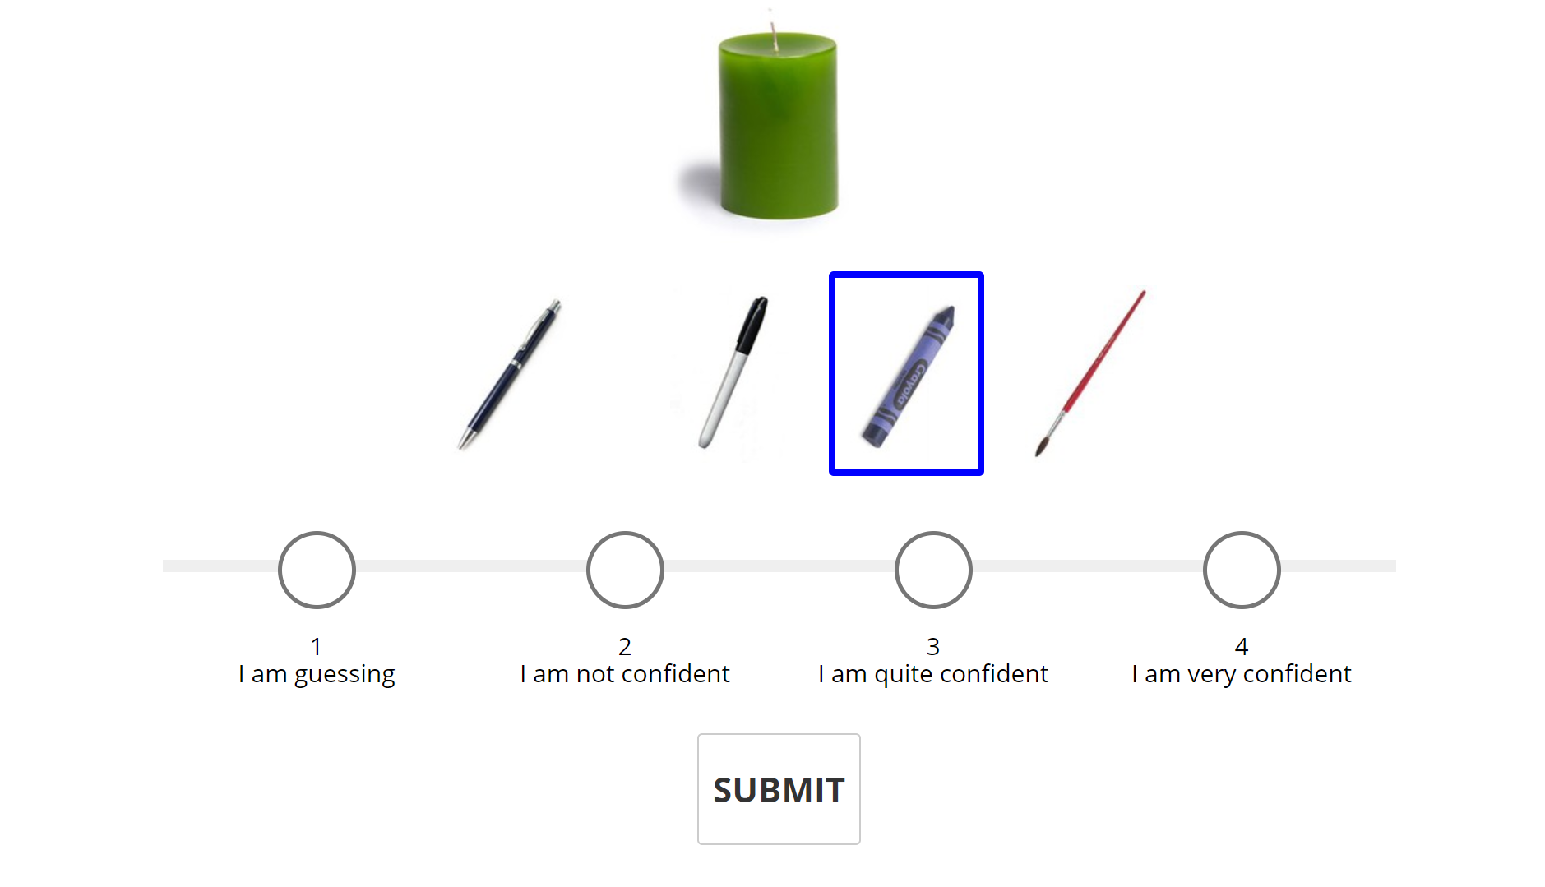
Linking word: wax Trial Concreteness (TC): 1.34 Common Setting (COM): 0.32 Visual Similarity (VIS):1.02

Slide 41
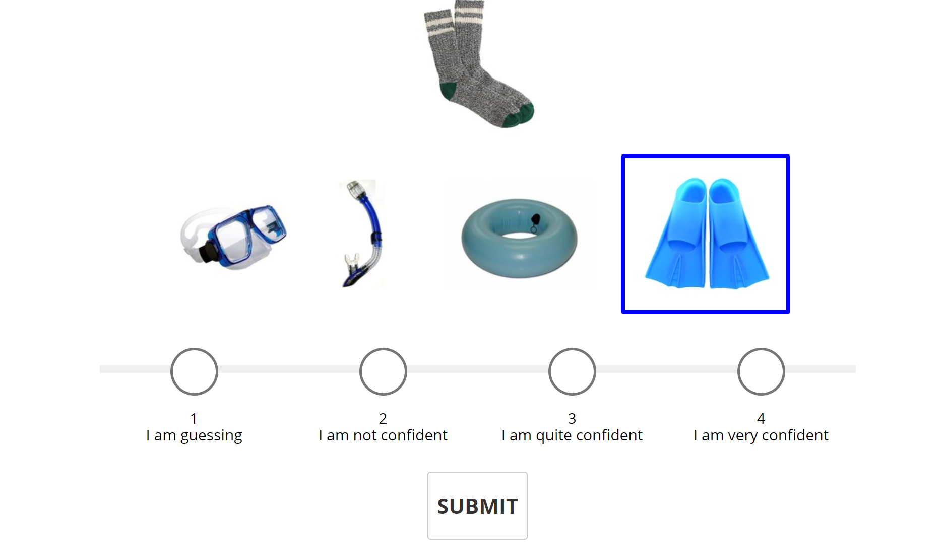
Linking word: foot Trial Concreteness (TC):1.36 Common Setting (COM): 0.04 Visual Similarity (VIS): 1.32

Slide 42
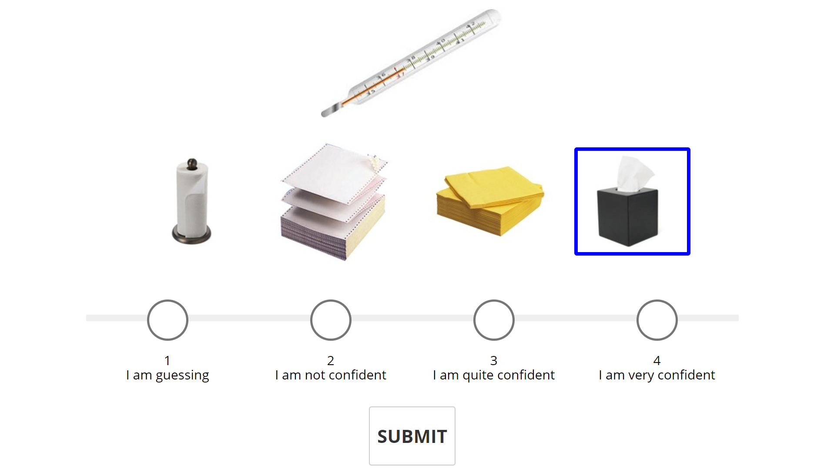
Linking word: sick Trial Concreteness (TC): 1.48 Common Setting (COM): 1.84 Visual Similarity (VIS):-0.36

Slide 43
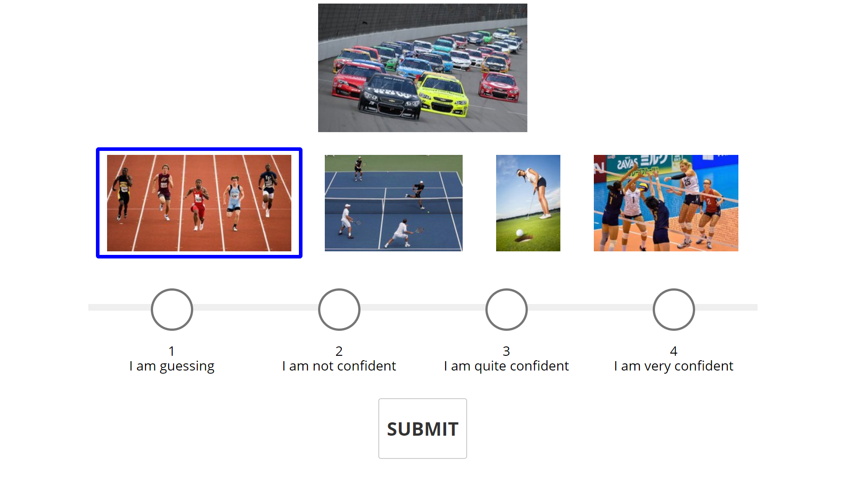
Linking word: race Trial Concreteness (TC): 1.51 Common Setting (COM): 0.22 Visual Similarity (VIS): 1.29

Slide 44
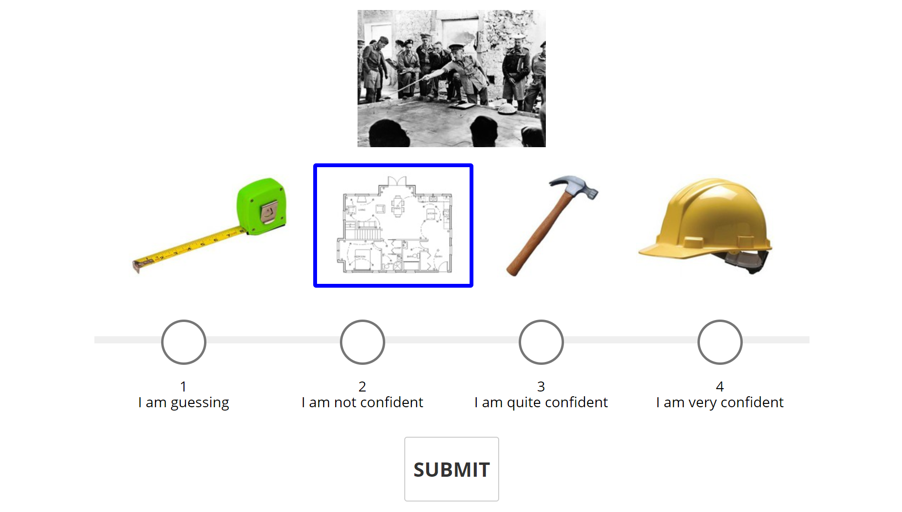
Linking word: plan Trial Concreteness (TC): 1.68 Common Setting (COM): 1.49 Visual Similarity (VIS): 0.19

Slide 45
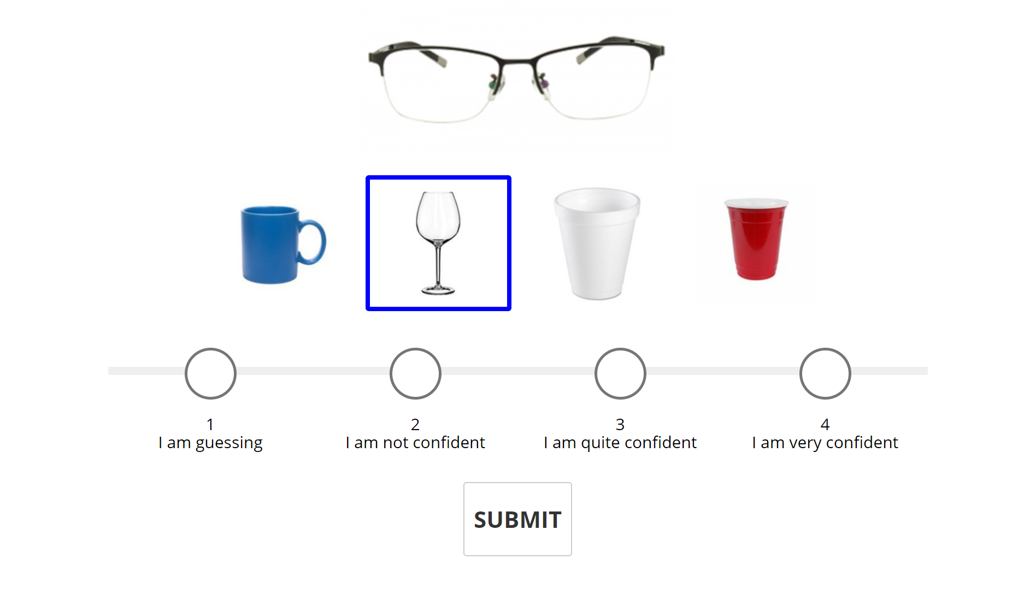
Linking word: glass Trial Concreteness (TC): 1.71 Common Setting (COM):0.15 Visual Similarity (VIS):1.56

Slide 46
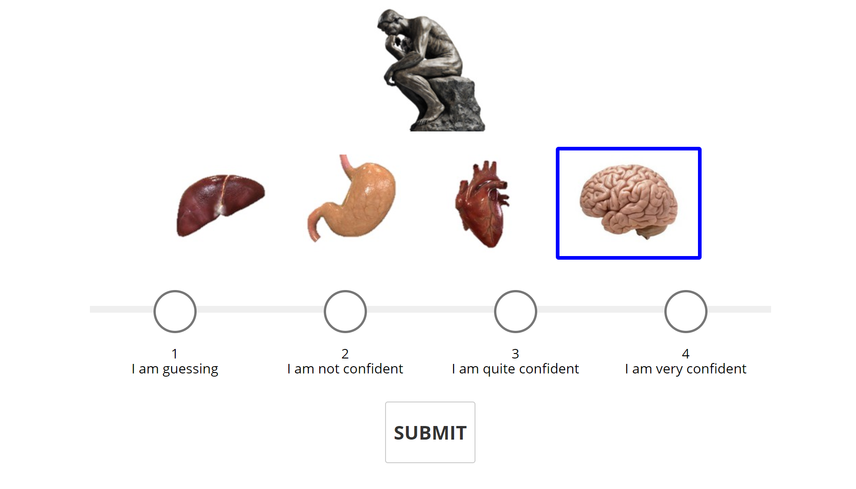
Linking word: think Trial Concreteness (TC): 1.85 Common Setting (COM): 0.91 Visual Similarity (VIS): 0.94

Slide 47
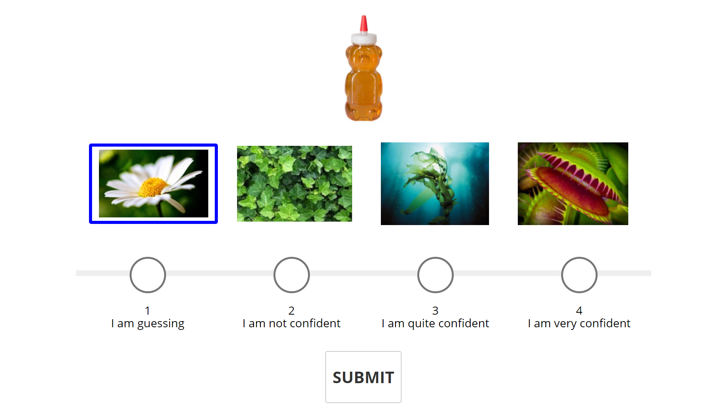
Linking word: bee Trial Concreteness (TC): 1.9 Common Setting (COM): 1.19 Visual Similarity (VIS): 0.71

Slide 48
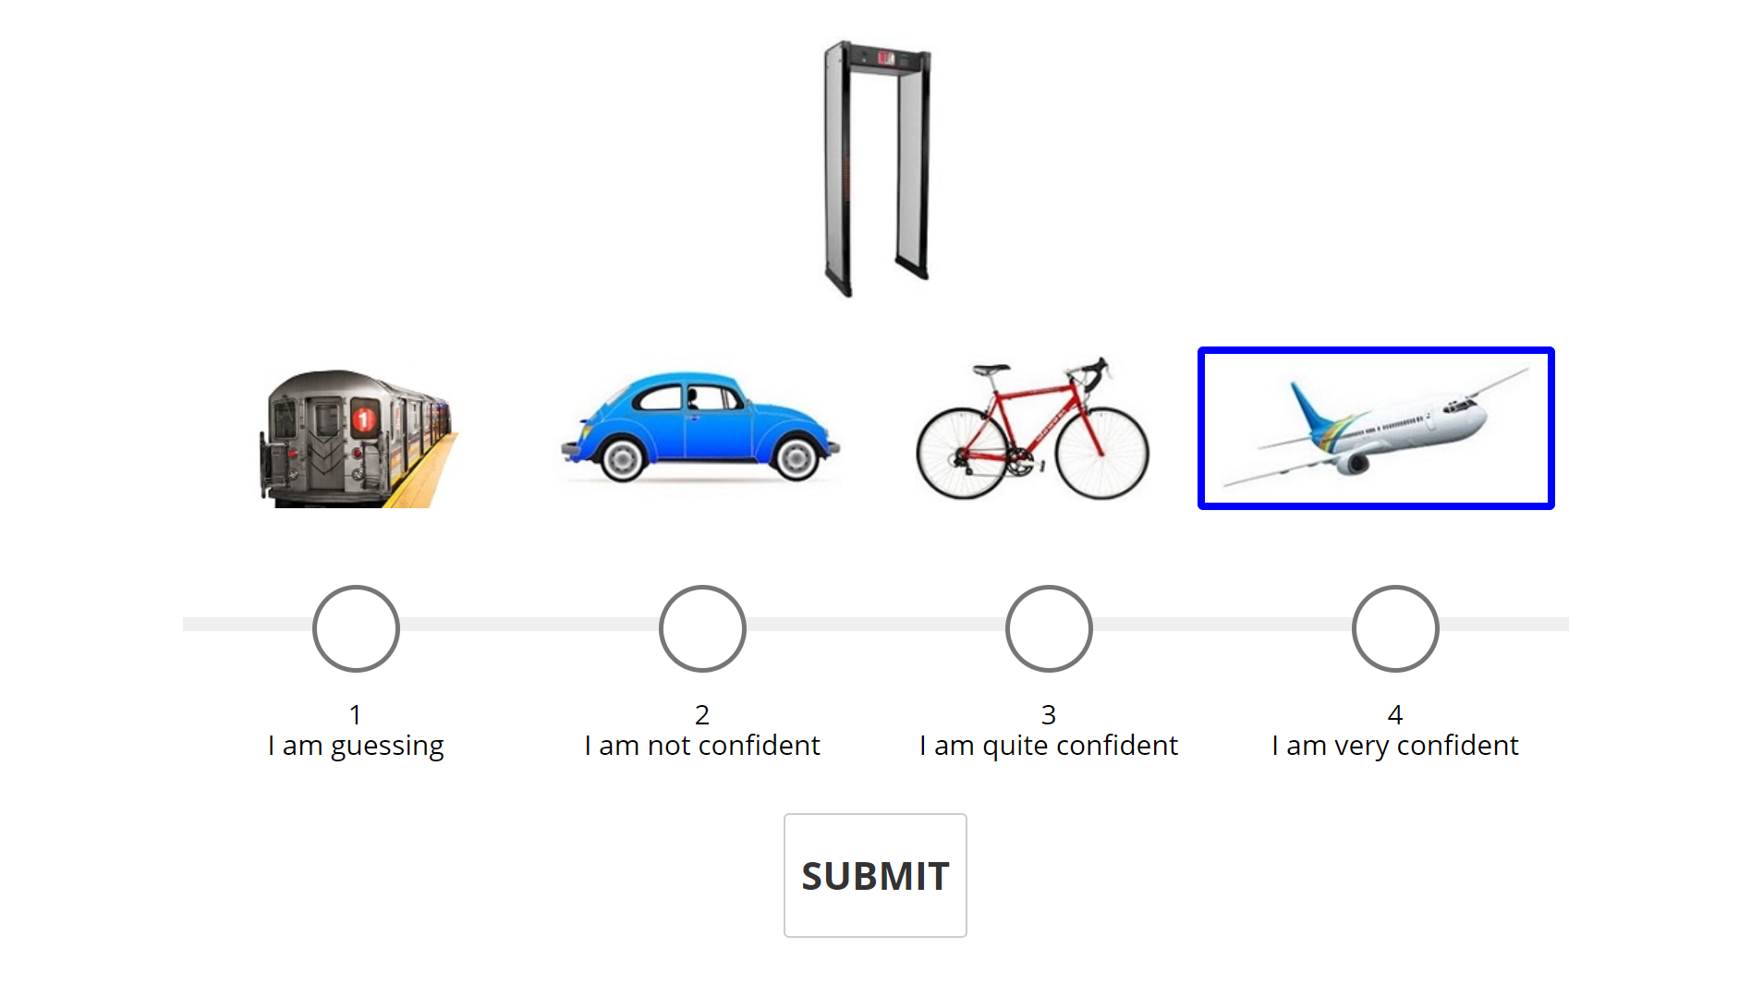
Linking word: airport Trial Concreteness (TC): 2 Common Setting (COM): 2.32 Visual Similarity (VIS): -0.32

Slide 49
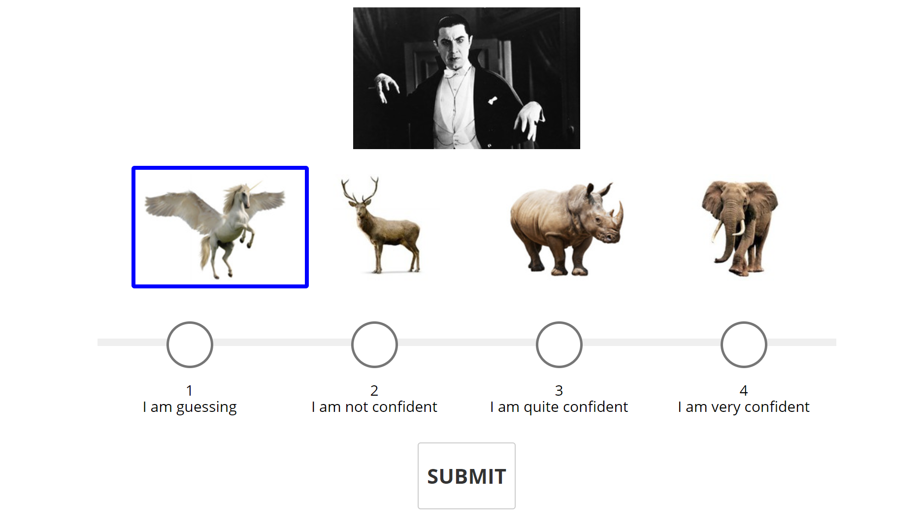
Linking word: myth Trial Concreteness (TC): 2.04 Common Setting (COM): 1.2 Visual Similarity (VIS):0.84

Slide 50
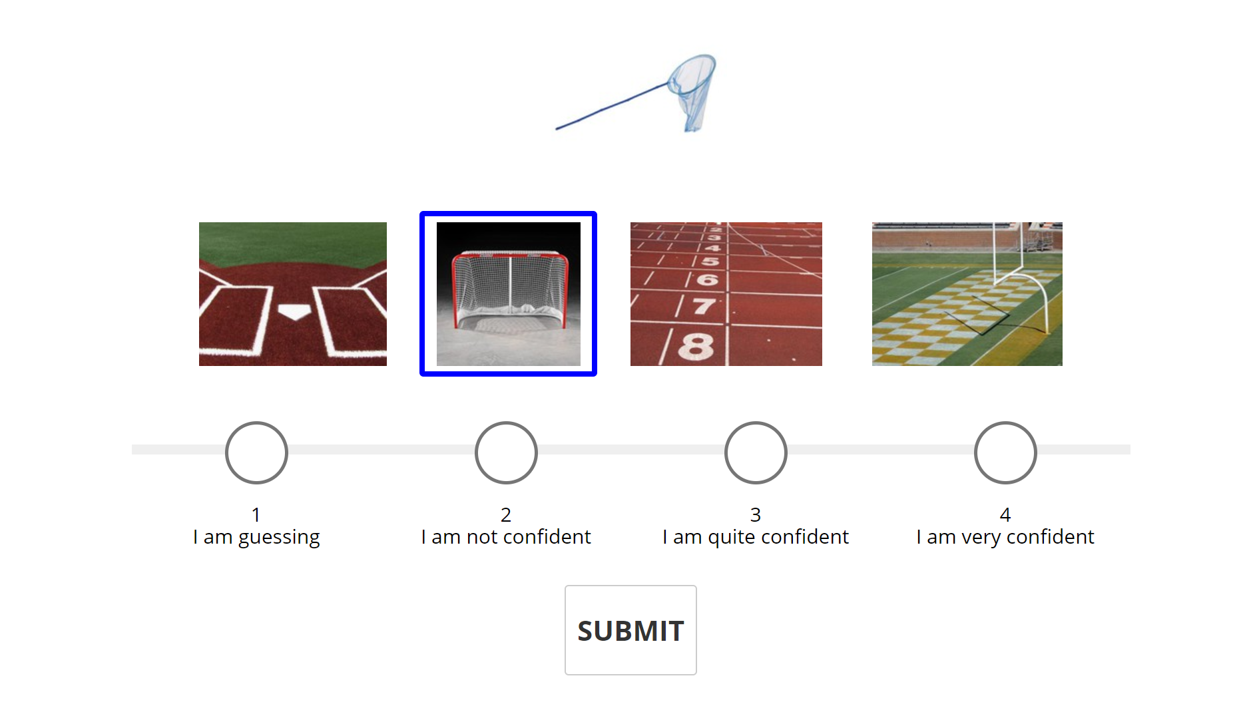
Linking word: net Trial Concreteness (TC): 2.22 Common Setting (COM): 0.28 Visual Similarity (VIS): 1.94

Slide 51
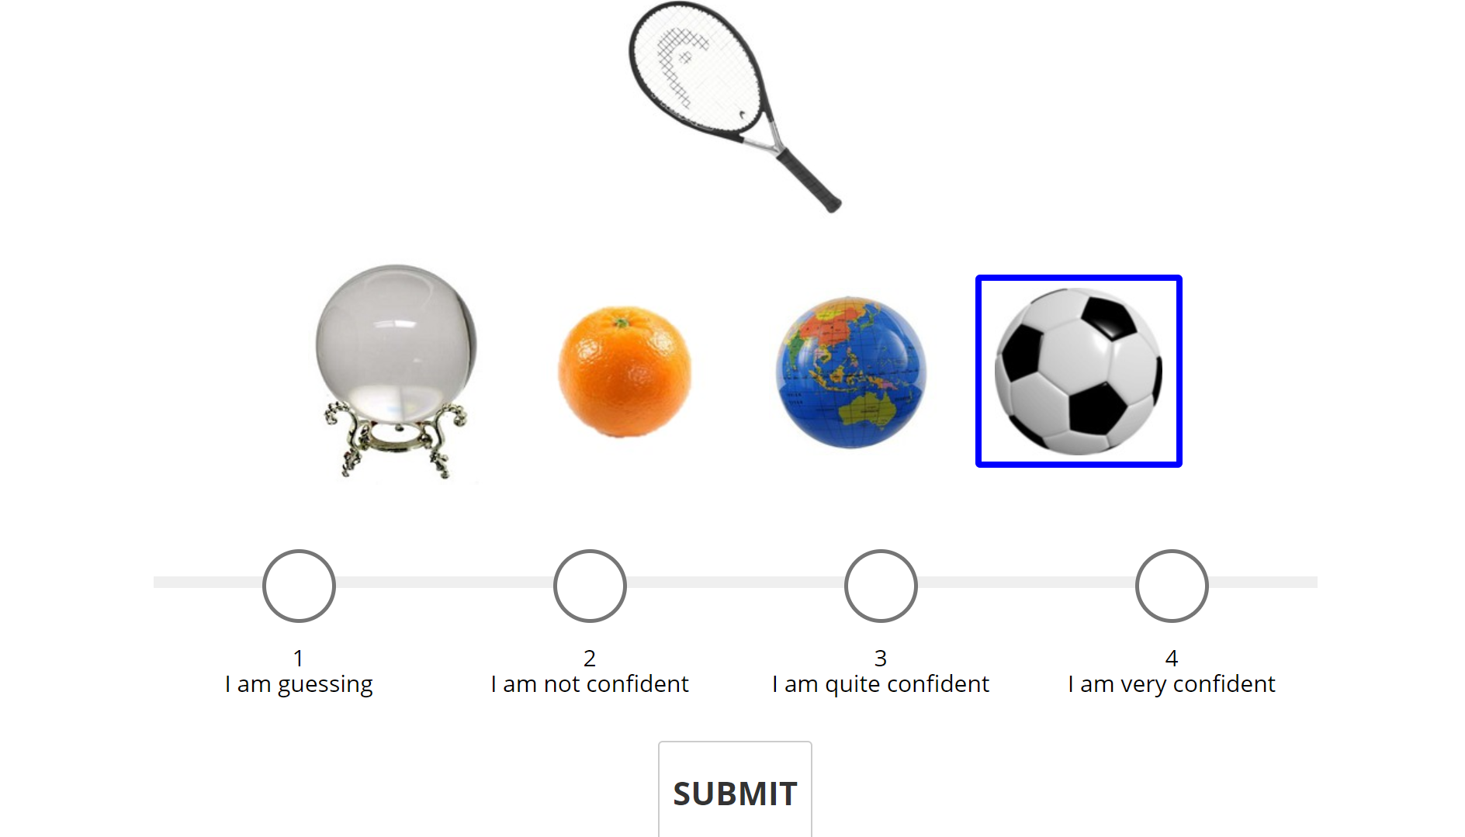
Linking word: sports Trial Concreteness (TC):2.32 Common Setting (COM): 1.52 Visual Similarity (VIS): 0.8

Slide 52

Linking word: cube Trial Concreteness (TC): 2.39 Common Setting (COM): 0.04 Visual Similarity (VIS): 2.35

Slide 53

Linking word: religion Trial Concreteness (TC):2.41 Common Setting (COM): 1.52 Visual Similarity (VIS): 0.89

Slide 54

Linking word: deliver Trial Concreteness (TC): 2.43 Common Setting (COM): 0.66 Visual Similarity (VIS): 1.77

Slide 55

Linking word: up Trial Concreteness (TC):2.56 Common Setting (COM): 1.76 Visual Similarity (VIS):0.8

Slide 56

Linking word: ocean Trial Concreteness (TC):2.58 Common Setting (COM): 2.58 Visual Similarity (VIS): 0

Slide 57

Linking word: luck Trial Concreteness (TC): 2.88 Common Setting (COM): 2 Visual Similarity (VIS): 0.88

Slide 58

Linking word: ninja Trial Concreteness (TC): 2.95 Common Setting (COM): 1.86 Visual Similarity (VIS): 1.09

Slide 59

Linking word: wait Trial Concreteness (TC): 3.08 Common Setting (COM): 1.92 Visual Similarity (VIS): 1.16

Slide 60


Linking word: real Trial Concreteness (TC): 3.11 Common Setting (COM): 1.44 Visual Similarity (VIS): 1.67

Slide 61

Linking word: dog Trial Concreteness (TC): 3.21 Common Setting (COM): 0.9 Visual Similarity (VIS): 2.31

Slide 62

Linking word: hat Trial Concreteness (TC):3.32 Common Setting (COM): 1.18 Visual Similarity (VIS): 2.14

Slide 63

Linking word: pool Trial Concreteness (TC): 3.4 Common Setting (COM): 3.16 Visual Similarity (VIS): 0.24

Slide 64

Linking word: baby Trial Concreteness (TC): 3.42 Common Setting (COM): 2.17 Visual Similarity (VIS): 1.25

Slide 65

Linking word: shoe Trial Concreteness (TC):4.22 Common Setting (COM): 1.32 Visual Similarity (VIS): 2.9

Slide 66

Linking word: farm Trial Concreteness (TC): 4.26 Common Setting (COM): 3.48 Visual Similarity (VIS):0.78

Slide 67

Linking word: safety Trial Concreteness (TC): 4.6 Common Setting (COM): 3.36 Visual Similarity (VIS): 1.24

Slide 68

Linking word: rain Trial Concreteness (TC): 4.68 Common Setting (COM): 3.7 Visual Similarity (VIS): 0.98

Slide 69

Linking word: paint Trial Concreteness (TC): 4.77 Common Setting (COM): 3.66 Visual Similarity (VIS): 1.11

Slide 70

Linking word: science Trial Concreteness (TC):4.89 Common Setting (COM): 4.24 Visual Similarity (VIS): 0.65

Slide 71

Linking word: knight Trial Concreteness (TC): 4.97 Common Setting (COM): 3.44 Visual Similarity (VIS):1.53

Slide 72

Linking word: justice Trial Concreteness (TC): 5.02 Common Setting (COM): 4.16 Visual Similarity (VIS): 0.86

Slide 73

Linking word: disco Trial Concreteness (TC):5.14 Common Setting (COM): 3.38 Visual Similarity (VIS): 1.76

Slide 74

Linking word: camp Trial Concreteness (TC):5.25 Common Setting (COM): 3.66 Visual Similarity (VIS): 1.59

Slide 75

Linking word: pirate Trial Concreteness (TC): 5.28 Common Setting (COM): 4.1 Visual Similarity (VIS): 1.18

Slide 76

Linking word: party Trial Concreteness (TC):5.9 Common Setting (COM): 3.86 Visual Similarity (VIS):2.04

Slide 77

Linking word: subway Trial Concreteness (TC): 6.44 Common Setting (COM): 4.68 Visual Similarity (VIS): 1.76

